Slide 1
Building Housing Smarter, Faster, Leaner
Lean Construction Ireland 21st June

Slide 2
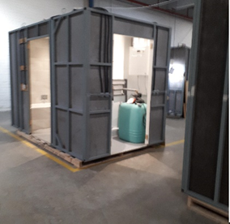
An Initiative of Enterprise Ireland under the Housing For All Plan
“The role of enterprise agencies will be expanded to include the provision of funding and supports for innovation and productivity-related projects in the domestic residential construction sector…”

Slide 3
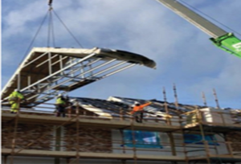
Vision
For Ireland to have the best home building industry globally.

Slide 4
Our Strategy

Slide 5
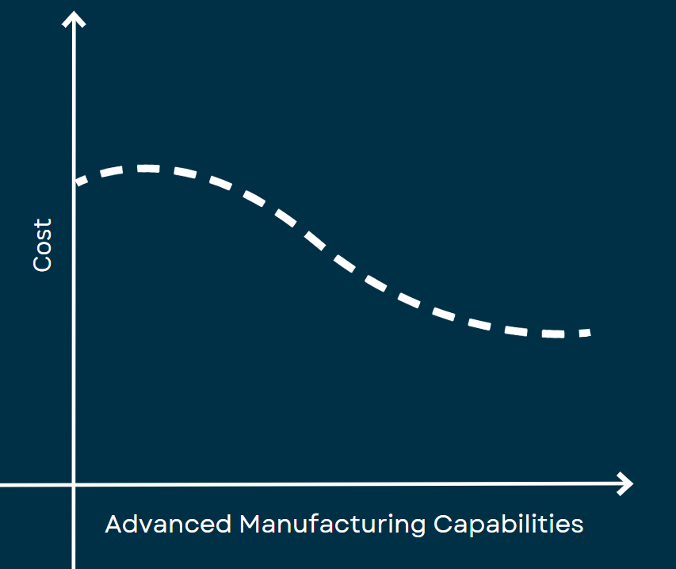
Cost Efficiencies

Slide 9
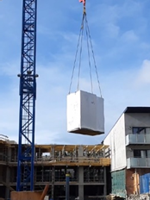
Innovation Roadmap

Slide 10
Lean & Digital Roadmap

Slide 11
Work With Us

Slide 12
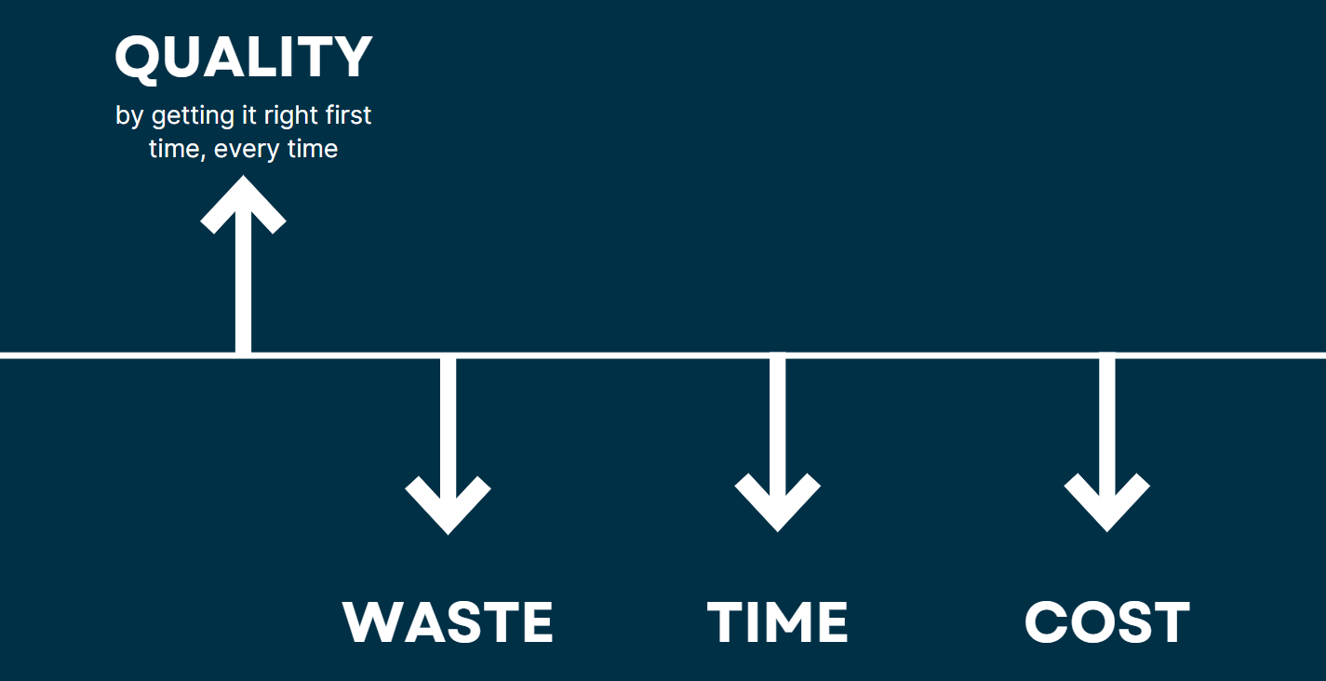
Results-Driven
Client companies who have implemented these projects have reported:

Slide 13
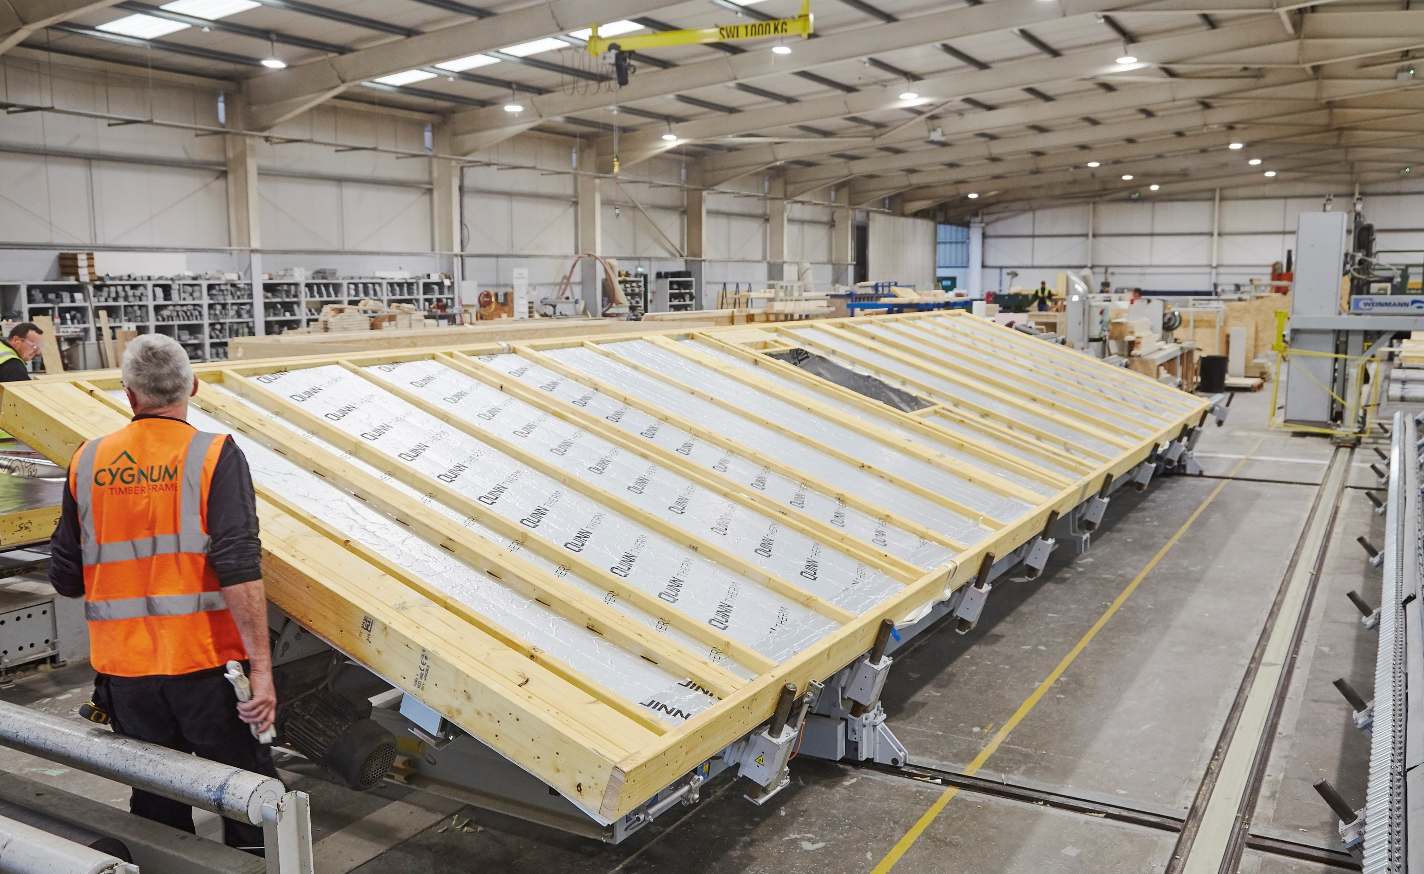
CYGNUM

Slide 14
CLANCY

Slide 15
builttoinnovate@enterprise-ireland.com
Thank you!

