Slide 1
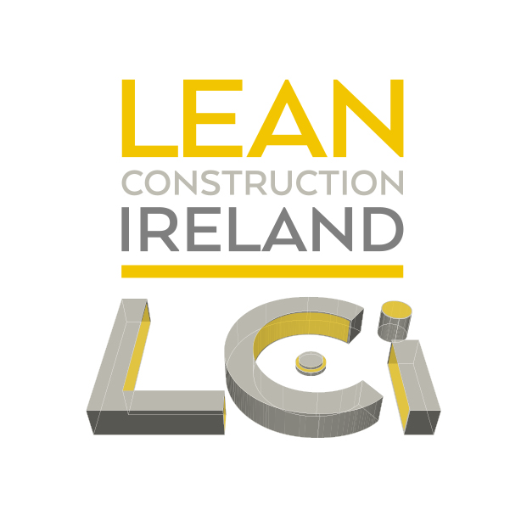
[INSERT WEBINAR TITLE]
WEBINAR TITLE | Sustaining the Last Planner System
PRESENTER | Kevin McHugh
ORGANISATION | Mace Technology Ireland
DATE | 23/03/2023
Notes:
Talk about the LPS from partially implemented to a more complete system use 2017

Slide 2
What's wrong with the way it has always been done
Challenge with Design/Construction
Waiting 25%
Information
Prerequisite Work
Materials
Equipment & Tools
Productive Time 42%
Non Productive Time 58%
Unnecessary Movement 13%
Unnecessary Material Handling 12%
Rework 8%
Manufacturing Waste = 26%
Source: Construction Industry Institute - CII
Notes:
Tradition project productivity.
Traditional top down ‘Critical path method’ is very reactive and can fragment teams. Traditional package contracting ‘fixed price, lump sum’ loads risks to the trade partners which again do not promote collaboration.
This results in fragmented teams working inefficiently with each other.
The LPS was adopted to break down silios and increase cooperation between project stakeholders.

Slide 3
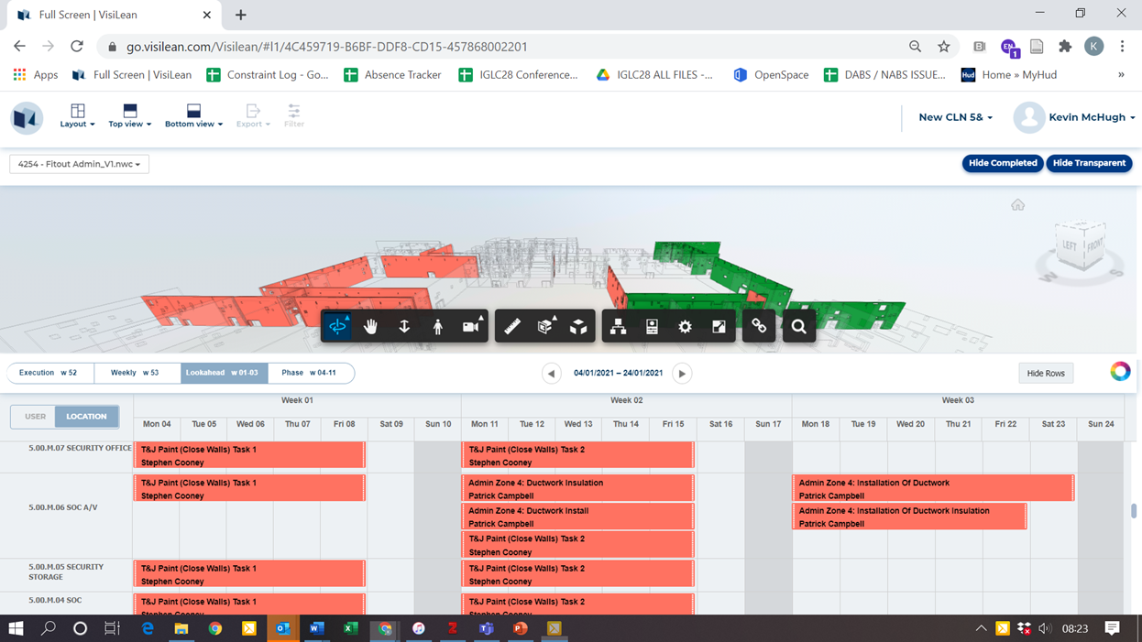
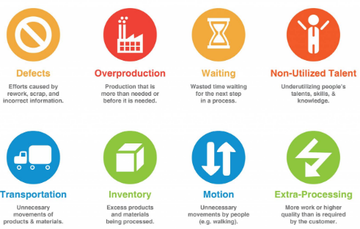
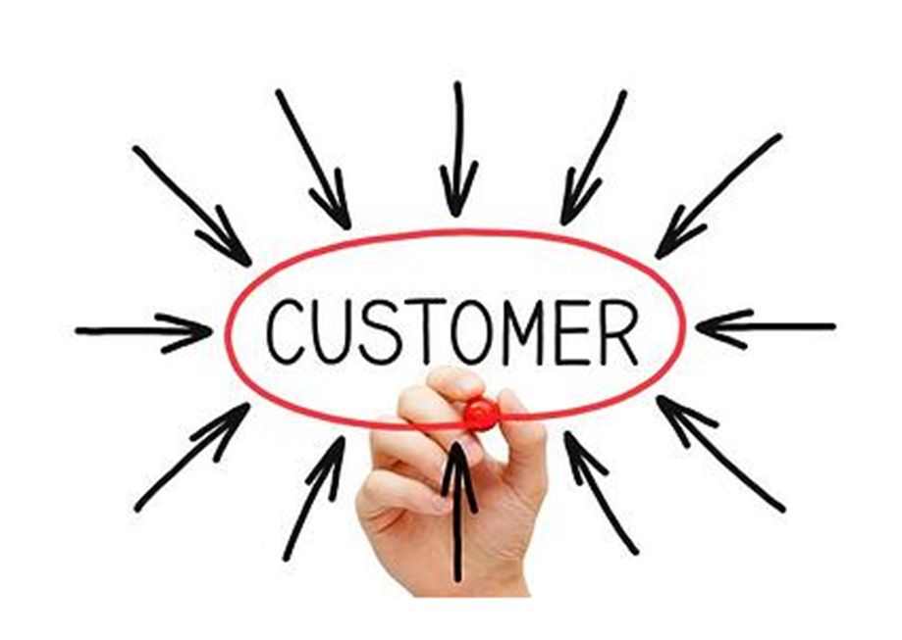
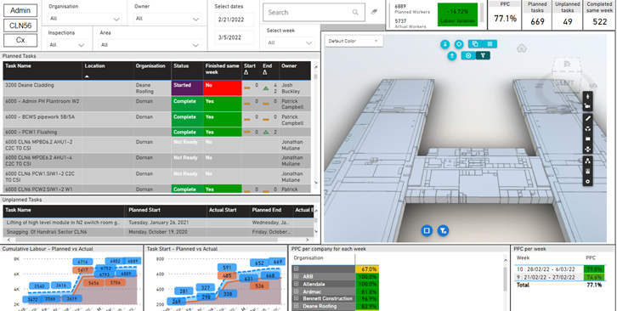
What is Value & waste in production
Notes:
Value and wastes are project specific and are based on customer’s expectation. Anything that adds a cost with no value is a project waste.
Customer and trade alignment is required to reduce wastes.
Lean Construction is focused on the systematic identification and removal of wastes using continuous improvement and collaboration to achieve this.

Slide 4
Why LPS
What is the Last Planner System?
The Last Planner System is a project production that promotes the creation of a predictable workflow among various parties so that it achieves reliable results. The LPS® allows potential hurdles to be found and addressed before they slow down the flow.
© Lci
Notes:
What is it…..
Uses available information to allow parties to collaborate….
Measures planned accuracy to provide continuous improvement…
We measure to understand production, we understand then can manage production, if we can manage then we can control production.
Ie Production Control System

Slide 5
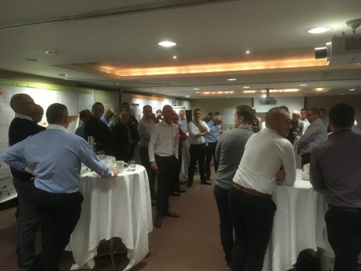
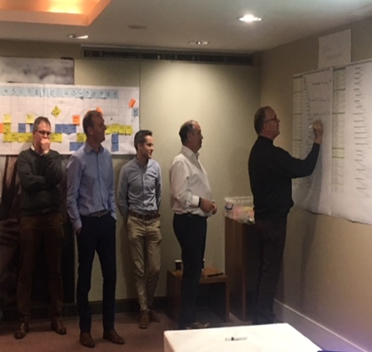
Integrated project delivery
Mapping day
Stakeholder Alignment Vender/Supply chain commitment
Site Team
Notes:
Every project is unique. An Integrated Project Delivery Model can promote team integration.
Each project requires team alignment from Design team , Construction team and Qa/Qc/Cx team to deliver the most value to the customer.
Effective communication supports the collaborative process.
Transparency and accountability keeps teams aligned and promotes continuous improvements

Slide 6
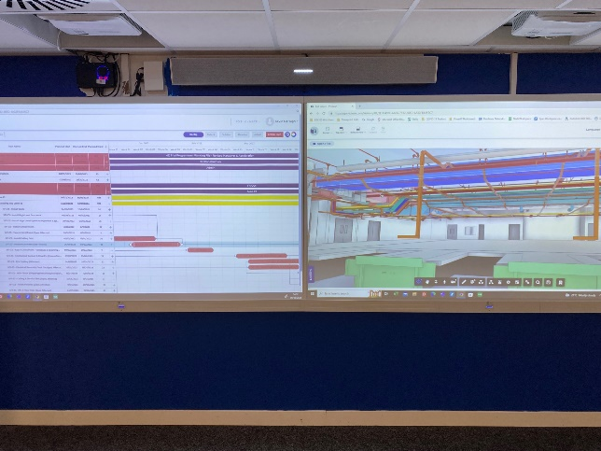
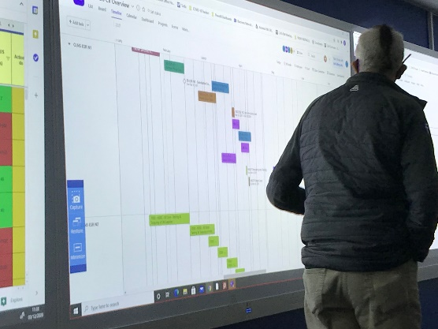
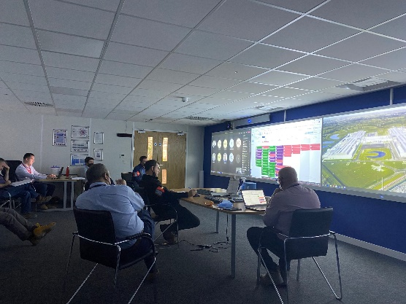
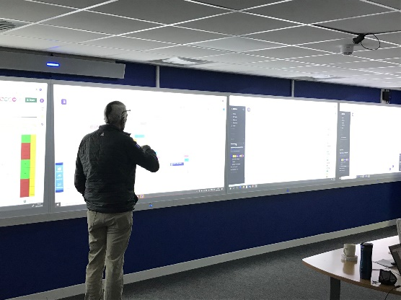
Collaborative planning
Structure
Workshop schedule – targeting Key pillars
Constraints & Opportunities Highlighted
Programme Agreed with all Stakeholders
Programme & Production Alignment
Notes:
Continuous mapping and integration is needed to build up more detailed short term look ahead plan.

Slide 7
Starting the LPS
Dec 2016
No Look Ahead Plans (Snapshots of Programme submitted)
No PPC of WWP (Actual tasks planned in the field untracked)
Ad hoc co-ordination Meeting
Poor Attendance/ Wrong Attendee’s
Incomplete Plans
Incomplete Make Ready needs
No correlation at Dab’s (Daily Huddle) – WWP not referred to
Plans created at daily huddle
No tracking of planed v actual
Disconnection from strategic planning to daily site planning
Jan 2017
Introduction of PPC tracking & review process the review and improve weekly production and short term look ahead coordination

Slide 8
New lps Jan 2017

Slide 9
Failure trends
Notes:
Highlighting failure reasons provided valuable field information to support project management teams.
PDCA cycle is followed to actively reduce/remove blockers to increase task success rate

Slide 10
Initial improvement
Notes:
Engaugement increased with the use and active management of constraints. Use of the LPS increased as trade contractors felt the benefits.

Slide 11
Increased engagement & quality
Notes:
Increase in the detail of tasks improved collaboration & increased productivity
Volume of tasks increased along with the execution of tasks

Slide 12
Findings
The last planner system engagement improved as each contractor realised how more efficient they were managing their resources
The quality of the information improved- Each trade communicated what was needed and this improved the quality of plans
Learnings from WWP were used to improve the project plans
There was a better understanding between trade contractors which increased collaboration
Behaviours changed positively- silo mentality was reduced and the success was review as a project success rather than a package success
Notes:
So we were able to improve control of our production. We reacted from good control (industry norm) the excellent control of our production.
How do we maintain and expect this level of control as standard and not as an intervention process.

Slide 13
Continuous improvement
Jan 2018
Meeting Structure was Stable
Opportunities for Improvement were observed from available data
LPS Meeting well attended
White board meetings referencing WWP
Actuals not completed
WWP not describing work
Not full campus engagement
Daily Huddle (DAB’s)/ Campus work planning not standardised
2020
WWP/LPS fully digitised
Design & quality and Cx functions added
BIM and WWP became more integrated
COVID Pandemic- Increased the use and reliance on digital information platform
Notes:
WE ensured that project production information and planning information was standard.
We identified opportunities for improvement and tools to support improvements
We identified that a single source of truth would increase transparency and improve engagement in the LPS campus wide.

Slide 14
Actuals resources and Quantity of work reviewed daily
Notes:
Increased information with tasks. Quantity of work expected and resource allocation planned in look ahead planning and managed in the field at daily whiteboard meetings

Slide 15
Excel to Digital Platform LPS April 2017
Average of 350 tasks per week

Slide 16
Platform ppc review
Notes:
Reporting was based on field updates. This improved the collaboration between stakeholders and allowed us to integrate project teams.

Slide 17
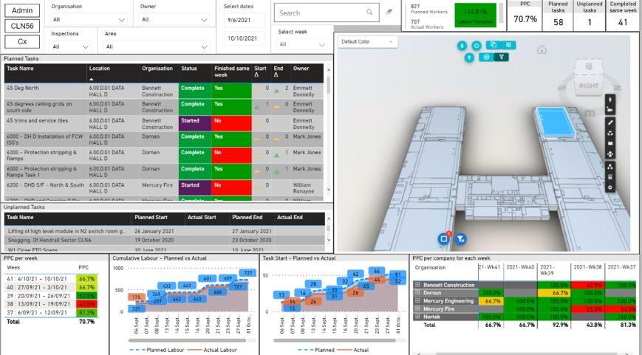
Digital data Integration
Notes:
Digital dashboarding provided near real time information to collaborate in a ‘Big room scenario’ where project stakeholders could collaborate.
The continuous improvement cycles and access to the LPS data from the field increased the trust between project stakehoders that in turn improved collaboration.

Slide 18
Use The plan
Mobile app is used for supervisors to update the status of their assigned tasks each day.
Increased visibility of weekly work plan status for each work area.
Increased quality of communication with ‘Live’ weekly work plan status
Plans are updated to current status before Dab’s briefing (Daily Activity Briefing)

Slide 19
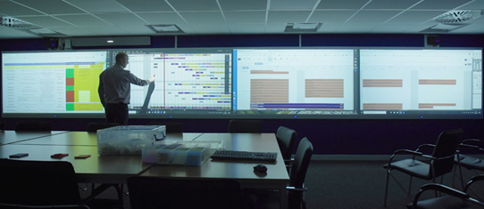
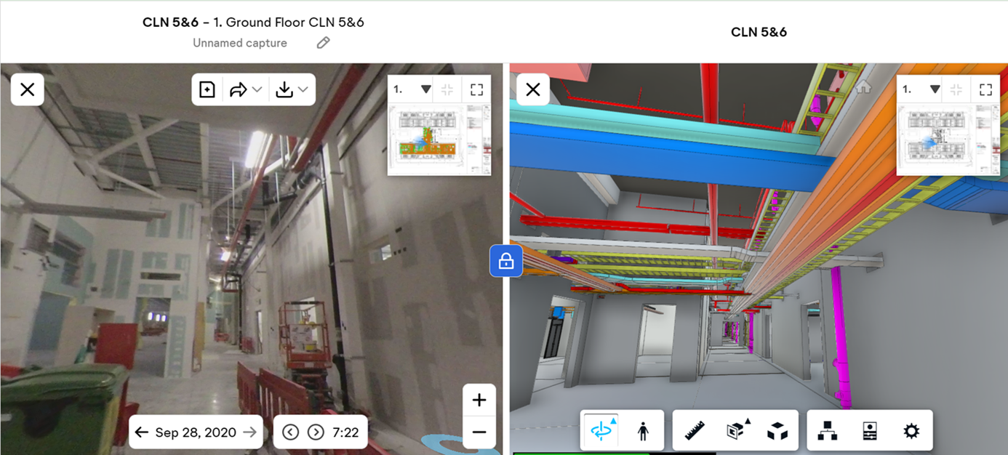
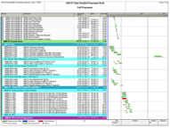
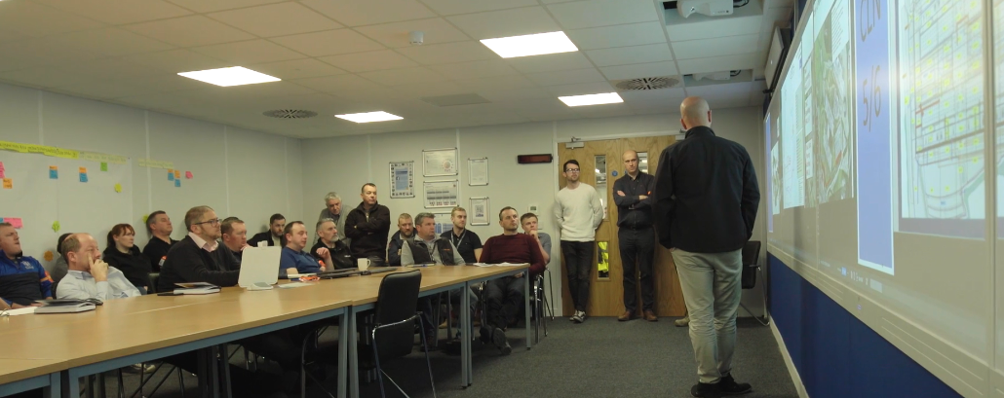
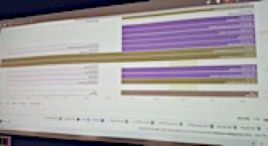
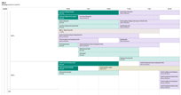
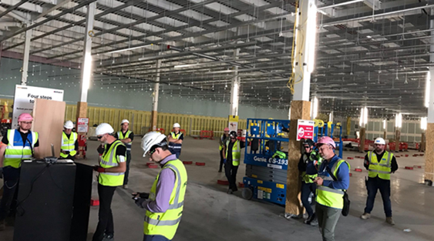
Continuous improvement
Long Range
Planning & Coordination
Short Range
Planning & Coordination
Master Schedule feeding filtered and aligned Contractor Programme
Captures all deliverables and high-level sequencing logic across the project
Progress drop lined each week during package reviews
6 Week Look Ahead
Captures all pre-construction and construction activities that should be completed along with potential blockers identified
Helps optimize sequencing logic to prevent potential clashes
Weekly Work Plans
Detailed plan of activities initially fed from 6-12 week Look Ahead
Validating, logic, sequencing, task duration, resources and all Make Ready Needs
As built record carefully checked each week for accuracy with Percentage of Activities Completed entered along with corresponding reasons for shortfall
DABS
Daily progress review
Plan v Actual on resource allocation
Daily schedule of planned activity to be tracked each day
Make ready needs identified and resolved
Strong link from master schedule to weekly work plans
Production Command Room
Visually illustrates a very clear factual status of the project so that anyone can swiftly get a clear understanding of the key issues and performance of the project and identify the key actions, their owners and next steps
increases awareness and active engagement across the team in the key issues, opportunities and successes

Slide 20
so why don’t we do it?
Lean Construction is growing in acceptance within the Construction industry, and more recently, within design as well.
The goal of Production Management is a smooth, even calm, system. It does not suit (or accommodate) firefighters, heroes, or reactionists.
It takes a lot of time and effort to maintain the plan. It is very transparent which can be uncomfortable with project stakeholders
Unique barriers to full Production Management implementation
teams distributed across the country (world),
Lack of training onboarding to production management
a reluctance to engage in transparent systems, and
smaller budgets which don’t allow for full time facilitationon a project-by-project basis.
It’s simple, but it’s not easy.

Slide 21
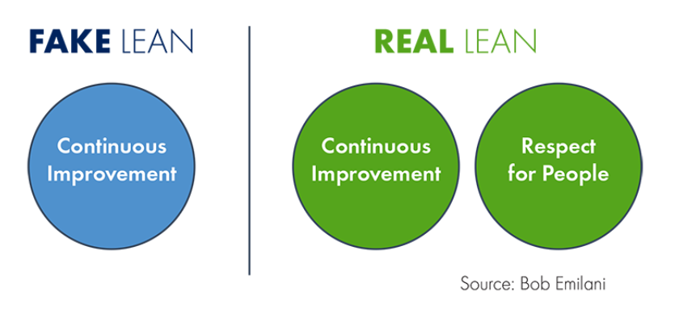
Kevin McHugh
Associate Director Construction
Pronouns: He/Him
Mace l
Ireland.
T +44 (0)20 3522 3000 l M +353 (87) 1961728 l macegroup.com
Connect with us l LinkedIn l Twitter l Instagram l YouTube
Notes:
The focus of improvements was to improve collaboration between project stakeholders. The process allowed trades to effectively communicate with each other. It gave them greater control and ownership of the system. This improved how people on the project interacted with each and with a greater understanding there was an increase in respect between people and disciplines that improved as the project continued. This improvement was focused on the users which helped improve and sustain the LPS process.

