Slide 1

[INSERT WEBINAR TITLE]
WEBINAR TITLE | THE POWER OF COLLABORATIVE PLANNING FOR PROJECT SUCCESS
PRESENTER | Karinne Zeringota – Co-Founder & Director Fawzi Nashat – Co-Founder & Director
ORGANISATION | Think Logic
DATE | 24th October 2024

Slide 2

Overview
1
What are your Project Challenges?
2
What is Collaborative Planning
3
Overview
Why Collaborative Planning & Who should be involved
4
What’s the best way to start?
5
Case study/Best Practices

Slide 3
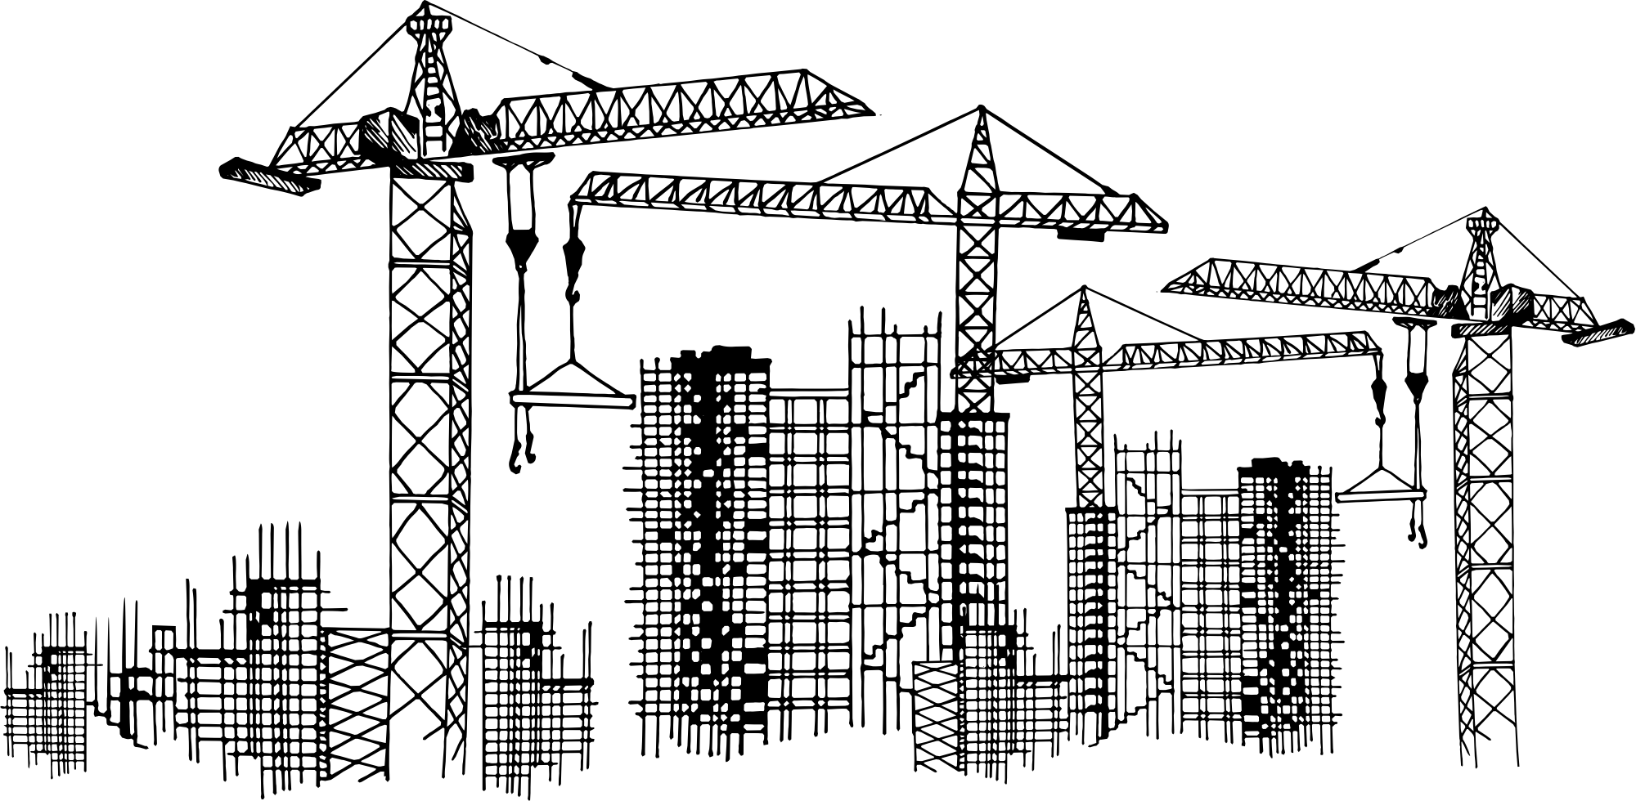







What are your Project Challenges?
DELAYS
OVERBUDGET
LOGISTICS INEFFICIENT
”Site logistics and material storage are a mess."
COMMUNICATION ISSUES
"Communication on-site is a mess – no one seems to be on the same page, and it’s causing constant mix-ups."
RE-WORK
SAFETY ISSUES
"Subcontractors don’t communicate properly, and it causes rework."
"Safety protocols are not being followed consistently on-site."
LACK OF PRODUCTIVITY
DESIGN CHANGES
"Every day it feels like we’re struggling to keep up – crews are moving too slowly, and we're missing daily targets."
"Frequent design changes are disrupting our workflow and driving up costs."
MATERIAL DELIVERY
"We’re constantly behind schedule because of delays in material delivery."

Slide 4
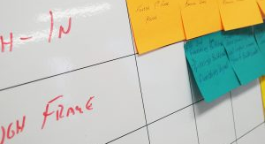

What Is Collaborative Planning ?
Is a collaborative scheduling technique used in project management, particularly in construction and manufacturing industries
Involves stakeholders from various roles and disciplines coming together to plan the project. This collaboration encourages communication, coordination, and alignment of goals among team members.

Slide 5
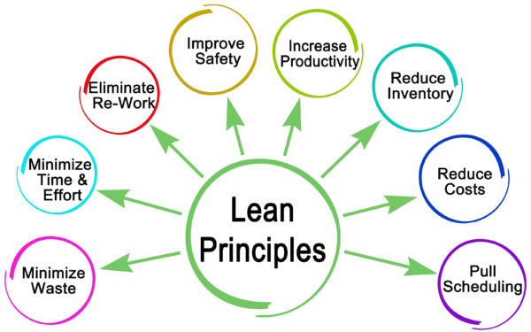
Why Collaborative Planning?
Emphasizes:
Control
Performance
Value
Delivery

Slide 6




Who Should Be Involved?
Subcontractors
03
04
Safety Officers
Site Supervisor
02
ON SITE
01
Architects and Designers
Project Manager
01
OFF SITE
02
Engineers & Technicians
Suppliers and Vendors
04
03
Clients/Owners

Slide 7
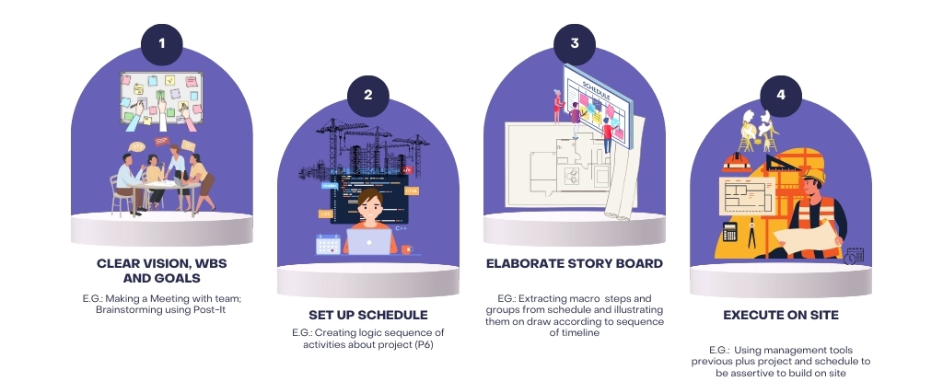
What’s the best way to start?

Slide 8
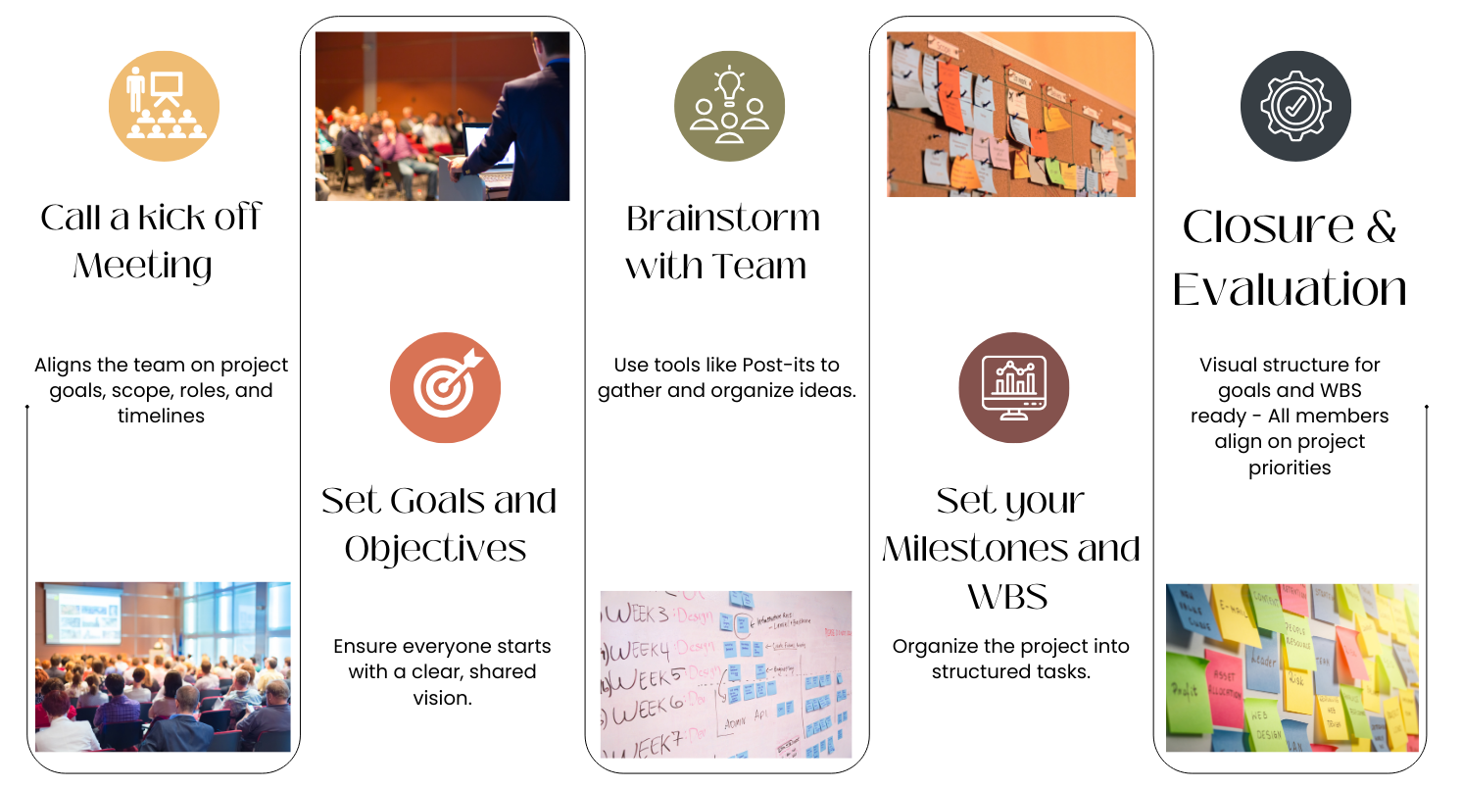
Clear Vision, WBS and Goals

Slide 9
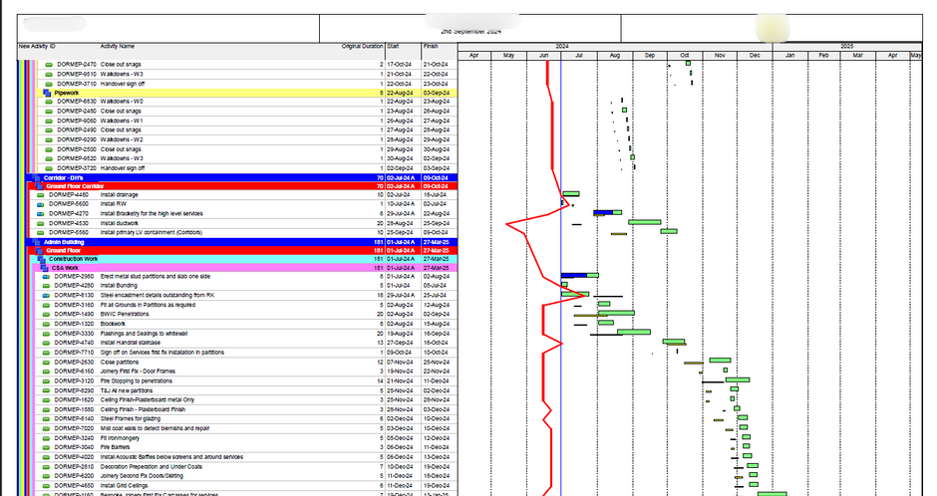
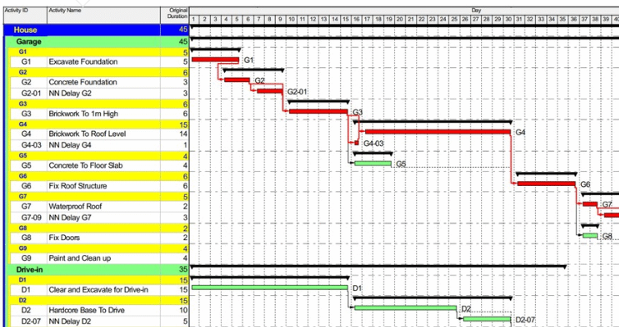
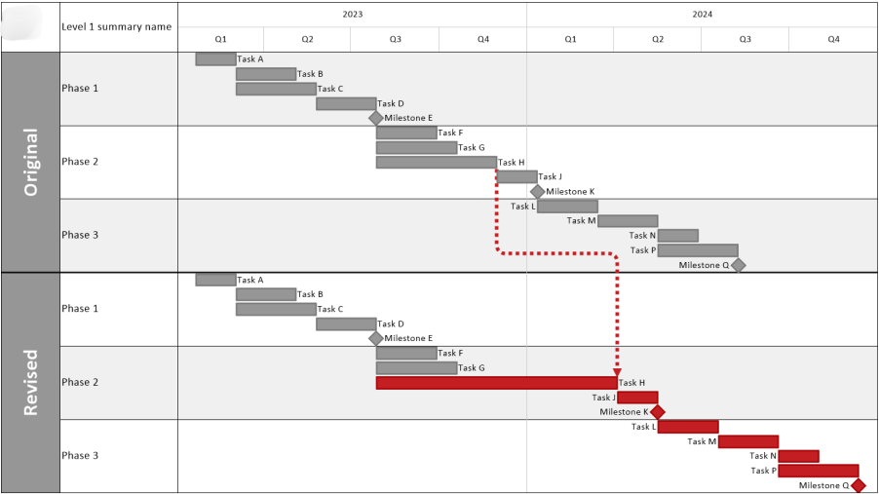
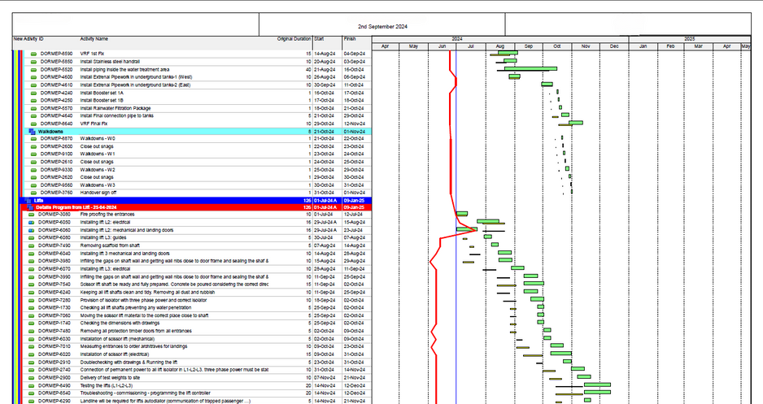
Set up Schedule

Slide 10
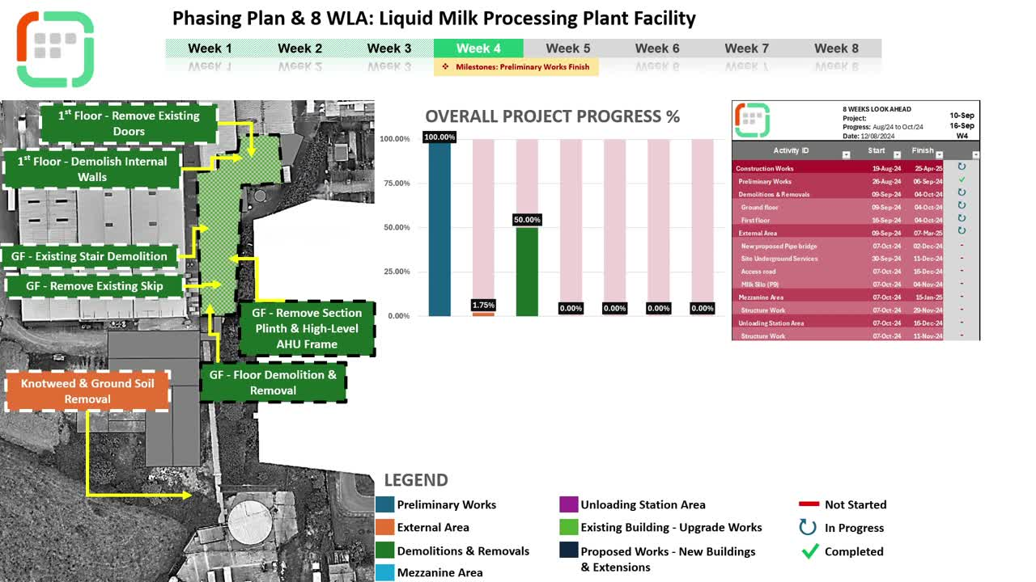
Elaborate Story Board

Slide 11
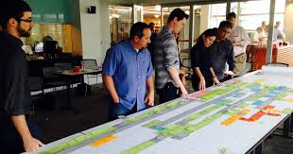
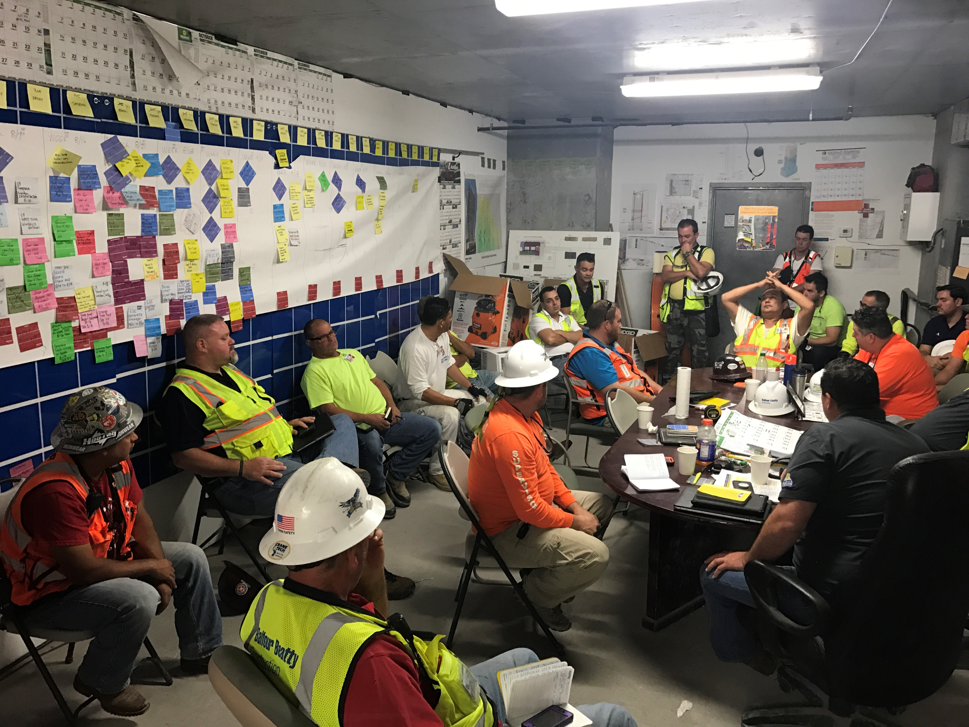
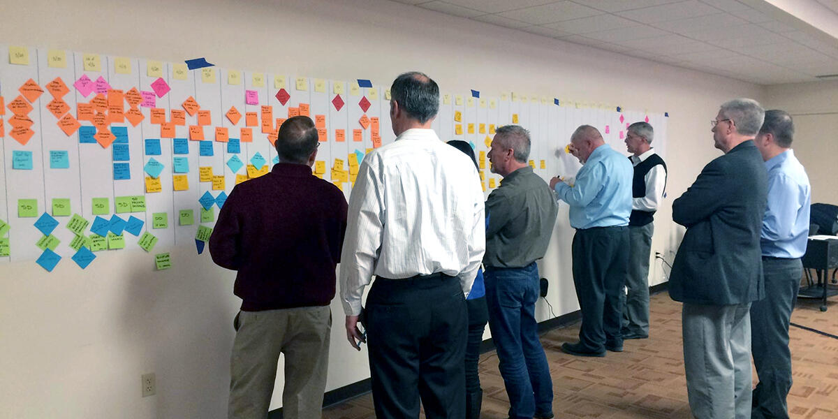
Execution on Site – Meeting

Slide 12
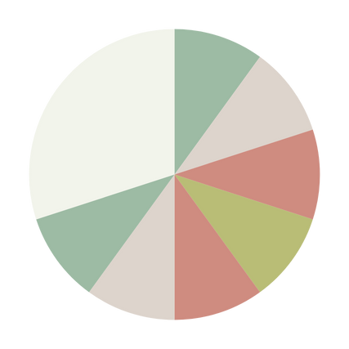
Benefits of Collaborative Planning
04
03
Improved Communication
05
Faster Decision-Making
Efficiency and Productivity
02
06
Enhanced Client Satisfaction
7
Mitigation of Risks
Benefits of Collaborative Planning
01
07
Better Resource Management
Less Errors and Rework

Slide 13
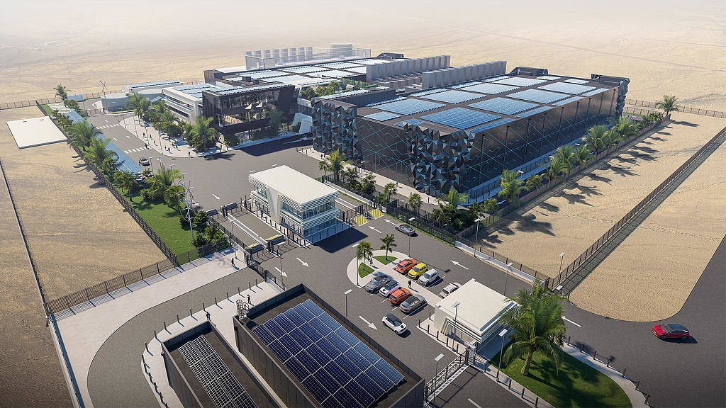
Case Study

Slide 14
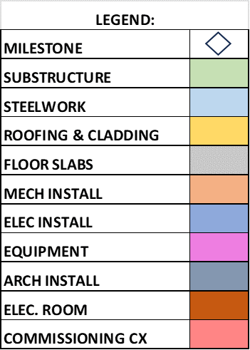
MONTH 1 | MONTH 2 | MONTH 3 | MONTH 4 | MONTH 5 | MONTH 6 | MONTH 7 | MONTH 8 | MONTH 9 | MONTH 10 | MONTH 11 | MONTH 12 | MONTH 13 | MONTH 14 | MONTH 15 | MONTH 16
SUBSTRUCT
START
SUBSTRUCT
FINISH
STEEL WORK
START
STEEL WORK
FINISH
ROOFING & CLADDING
START
ROOFING & CLADDING
FINISH
FLOOR SLAB
START
FLOOR SLAB
FINISH
MECH INSTALL
START
MECH INSTALL
FINISH
ELEC INSTALL
START
ELECT INSTALL
FINISH
EXT. GEN TX
START
EXT. GEN TX
FINISH
ARCH. INSTALL
START
ARCH. INSTALL
FINISH
ELEC.ROOM INSTALL
START
ELEC.ROOM INSTALL
FINISH
PRE-COMMISS
START
RED TAG
YELLOW
TAG
GREEN
TAG
HANDOVER

Slide 15


