Slide 1
[INSERT WEBINAR TITLE]
WEBINAR TITLE | Learning Management Systems & Personal Development
PRESENTER | Patrick Matthews (Technical Training Manager)
ORGANISATION | Ardmac Ltd
DATE | 27th July 2023

Slide 2
Contents
Section 1: Learning Management System
The what and why behind what we want to achieve
Maximising Productivity
Learning Management System Definition
The Eight Wastes
Value v’s Non-Value Activities
Activities Overview
What we needed
Benefits of an LMS
Section 2: Personal Development
Personal Development Definition
Career pathing
Types of Career Paths (Incl. examples)
Career Path Success
Outputs

Slide 3
Section 1: Learning Management System

Slide 4
What are we trying to achieve?
How can we manage and motivate a workforce that will execute the business strategy?
Engagement
Attraction and Retention of Talent
Investment in skills and Employee Development
Compliance
and Technology

Slide 5
The Why?

Slide 6
Maximising Productivity
When we maximise Employee Productivity,
We bring our teams together, meaning……
Business Goals
Project Goals
Team Goals
Achievement of all goals are easier to achieve when everybody knows what they need to do!
Are all achieved

Slide 7
Learning Management System
Definition:
A learning management system is a software application for the administration, documentation, tracking, reporting, automation, and delivery of educational courses, training programs, materials or learning and development programs.

Slide 8
The Eight Wastes
Transportation – Unnecessary moving of products or information that doesn’t add value.
Inventory – Excess production or storage of stock, materials or information.
Motion – Unnecessary or wasted movement, that doesn’t add value.
Waiting – Unnecessary waiting or delays on products or information that is required to be processed or worked on.
Over Production – Producing products that is greater than the demand.
Over Processing – too many steps in the process (duplicating or too many steps in the process).
Defects – Failing to produce or deliver a product or service that is acceptable to the customer. Can involve rework.
Skills Underutilised – Involves not using the skills at your disposal, in terms of problem solving.

Slide 9
Value v’s Non-Value Activities
What are value added processes?
The value-added process is how a company defines which activities and processes add value to their products, services or overall business.
This can be broken up into three types of activities:
Add Value – as a result of the activity we transform materials or information into a product or service the customer see’s value in.
Necessary Activities – Activities that are required and will consume resources but not necessarily add or contribute to the product or service.
Waste – Activities that can be taken out of the process that don’t directly contribute to the product or service.

Slide 10
Activities Overview
Add Value
Necessary
Waste
Training is booked
Training is completed
Certificate is received
Person is deemed competent
Booking of Training
PO Process (Payment)
Recording of Training
Record of certification
Tracking of Training
Excess Transport
Training records being managed by multiple depts.
Over Processing
Training records being processed and stored in multiple locations
Multiple Reports
Motion
Time spent looking for training records
Waiting
Certs to be passed between depts.

Slide 11
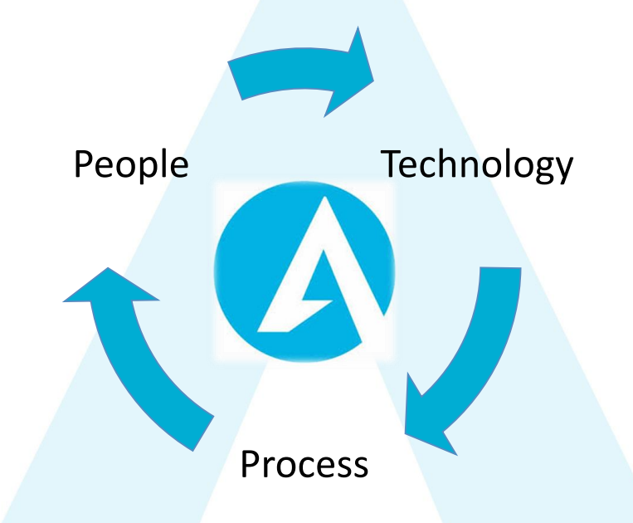
What we needed
A learning Management system that is fit for purpose.
A single source of truth.
User Friendly with Engaging Learning content across the group.
Training Dashboard’s.
Reports – Custom & build your own.
Compliance (Training completed & not completed).
Connects seamlessly with our HR Information System.
An efficient system that freed up people's time.
4 of the 8 wastes removed

Slide 12
Benefits of an LMS
Single source of truth
All training records in one location
Administration time cut by up to 30%
Efficient process in place
Easy to use
User friendly and easy to navigate around the system
Cost effective
Flexible
The LMS grows and shrinks on demand according to your needs
Customizable
Use your own custom branding
Mobile-ready
Mobile apps available on both iOS & Android,
Same learning experience whether using their laptops or phones
No maintenance
Free you from installation, setup, and maintenance (efficiency).

Slide 13
Section 2: Personal Development

Slide 14
Personal Development
Definition:
Personal development or self-improvement consists of activities that develop a person's capabilities and potential, build human capital, facilitate employability, and enhance quality of life.
A professional development plan, is a document outlining your career goals and the path you can take to reach them

Slide 15
Career Pathing
What is a Career Path?
A career path is:
A list of steps to take in your professional life.
A clear route for progression (more advanced/senior roles at work).
A series of jobs and experiences that help employees reach their ultimate career objectives and future goals.
Benefits:
Employees are more engaged in their job.
Role & Goal Clarity.
Build long-term relationship with the company (retention).
Improves employee morale.
Succession Planning.

Slide 16
Types of Career Path
What Are the Different Types of Career Paths?
Career paths can be vertical or horizontal
This is dependent on a number of variables,
Opportunities within the business.
Employees preferences.
Employees future aspirations.
People view career paths as always being Linear
This is not always the case!
Vertical career paths
Advancement to higher-level positions or movement to a lower-level position.
Dependent on the individual (desire for increased or decreased job responsibility).
Horizontal career paths
Include lateral movement either within a particular function or cross functional.
Allows the individual to learn new skills or get exposure to different projects and scenarios.

Slide 17
Examples of Career Paths
Vertical Construction Career Paths:
GO/Trade ↗ Supervisor ↗ Foreman ↗ Site Manager ↗ Project Manager ↗ Contracts Manager.
Graduate Quantity Surveyor ↗ Junior Quantity Surveyor ↗ Project Quantity Surveyor ↗ Senior Quantity Surveyor ↗ Managing Surveyor ↗ Commercial Manager.
Human Resource Admin ↗ Human Resources Officer/Generalist ↗ Human Resources Business Partner ↗ Human Resources Manager ↗ Director of Human Resources.
Horizontal Construction Career Paths:
Construction Graduate → Junior Quantity Surveyor.
Finance Assistant → Trainee Estimator.
Project Engineer → Project Management.

Slide 18
Career Path Success
How Do You Follow a Career Path?
To successfully follow a specific career path, the following considerations and supports must exist:
Employee Ownership of the process.
Willingness to continuously learn.
Providing a Mentor & Coach.
Career Counselling.
Flexibility to adjust your goals if career preferences change.
Occasionally take a lateral move to gain more knowledge/skills.
Resilience and perseverance.

Slide 19
Outputs
What are our desired outputs?
Leadership capability
Workforce performance and capability
Engagement
Productivity
Identification of training/skills gaps
Identification of Future skills needs

Slide 20
What do we get?

Slide 21
“An investment in knowledge pays the best interest.”
- Benjamin Franklin

