Slide 1



Resolute PV

Slide 2


Slide 3
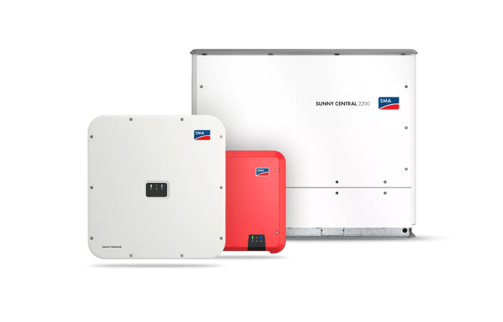
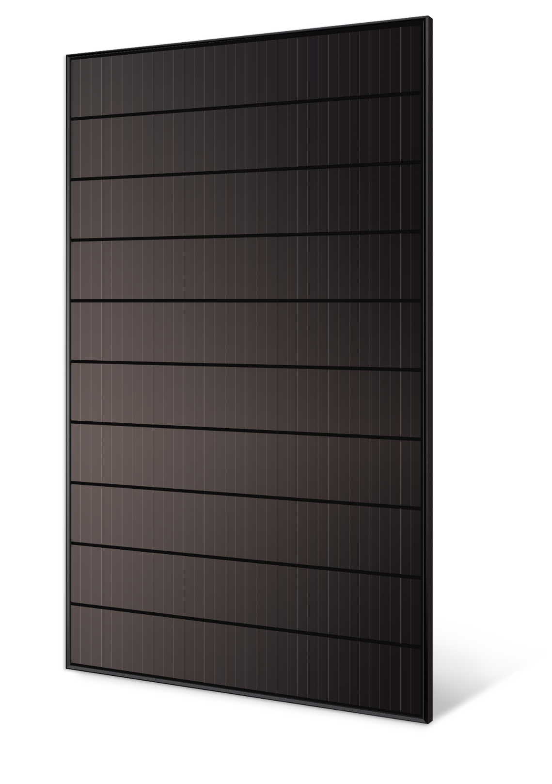
The Basics
Notes:
In principle, PV is simple; it only has two main components.

Slide 4
Why select a particular panel over another?
Notes:
Higher wattage = Bigger panel

Slide 5
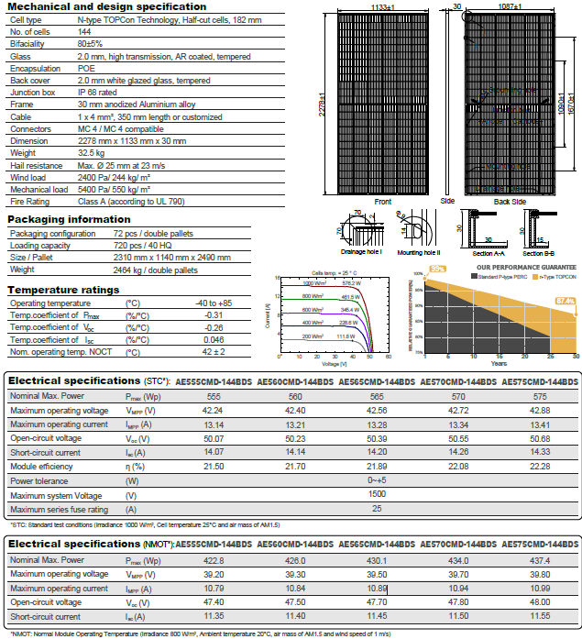
PV Panels
2.58
554.909
575.04
Notes:
STC: Standard test conditions (Irradiance 1000 W/m2, Cell temperature 25°C and air mass of AM1.5)
PV panels are all about the efficiency. The rating is the efficiency x 1000 by the are is the wattage.

Slide 6
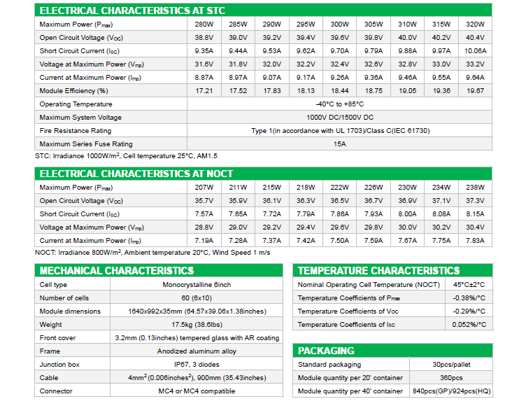
320.009
1.62
Notes:
STC: Standard test conditions (Irradiance 1000 W/m2, Cell temperature 25°C and air mass of AM1.5)
PV panels are all about the efficiency. The rating is the efficiency x 1000 by the are is the wattage.

Slide 7
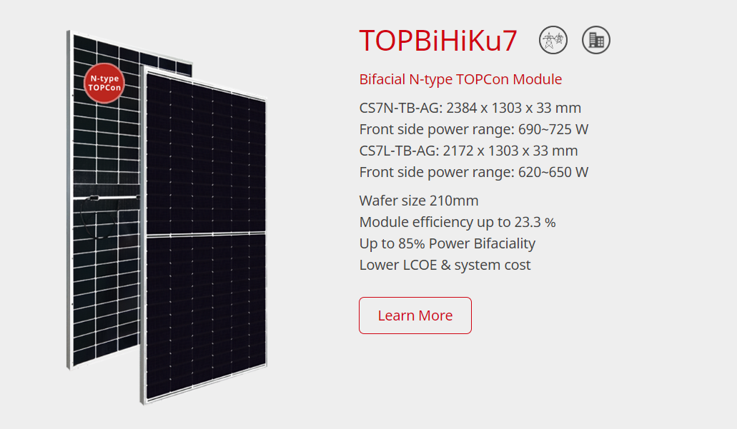

Slide 8
Inverters
Central / String / micro
Up to 3960 kVA with a central
Up to 110kVA/315kVA in a String inverter
Up to 3.3kWp in a Microinverter
Notes:
Up to 50% DC input oversize Very handy for getting most out of Microgeneration. Up to 15kWp

Slide 9
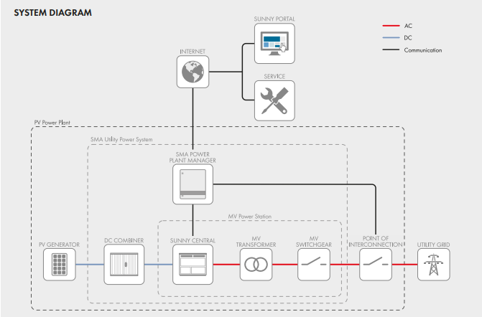

Central Inverters

Slide 10
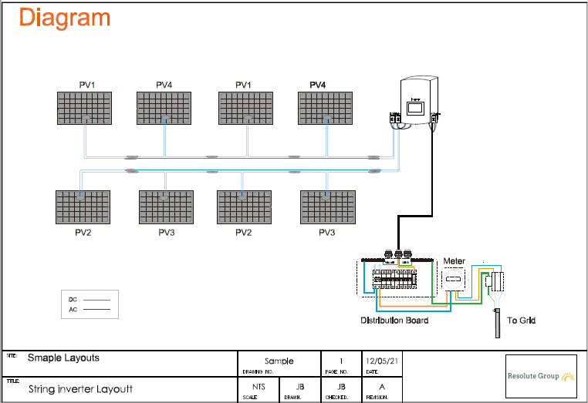
String Inverter
Notes:
This is the basic Solar layout for a string configuration.

Slide 11
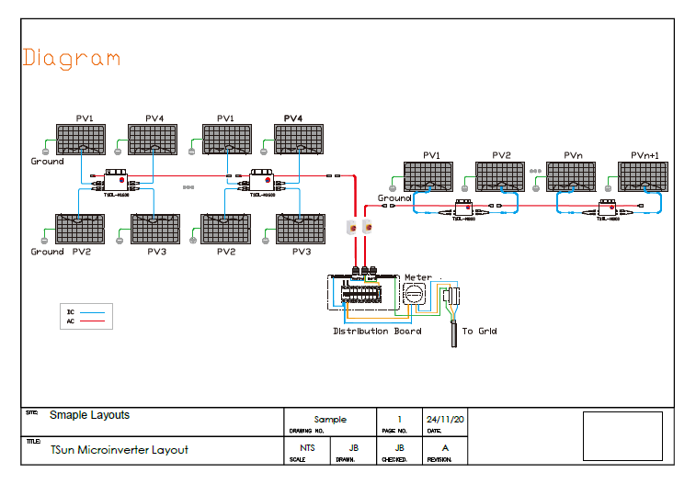
Micro-inverters
Notes:
Basic for a microinverter layout.

Slide 12
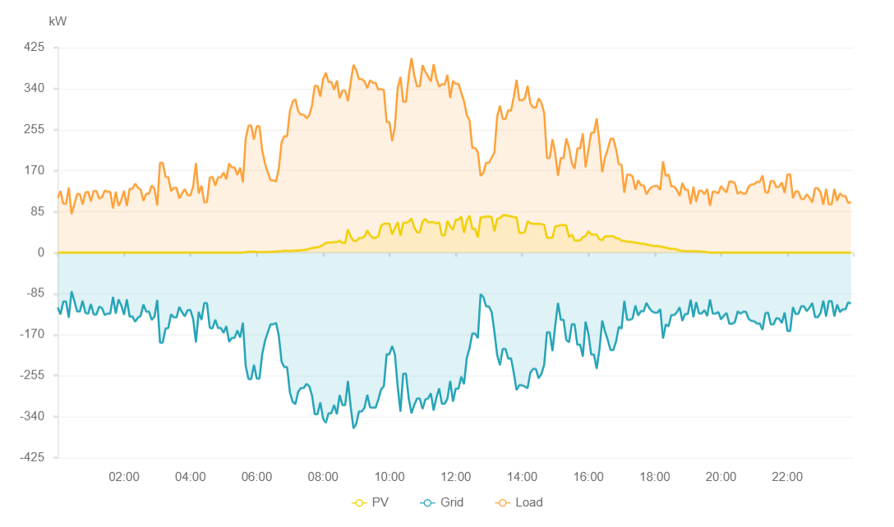
Why can you oversize the PV array?
Notes:
128kWp system in E/W on a 5deg pitched roof.
Orientation E/W won’t produce a peak at the same time.
STC being 100W/m2 and 25degC

Slide 13
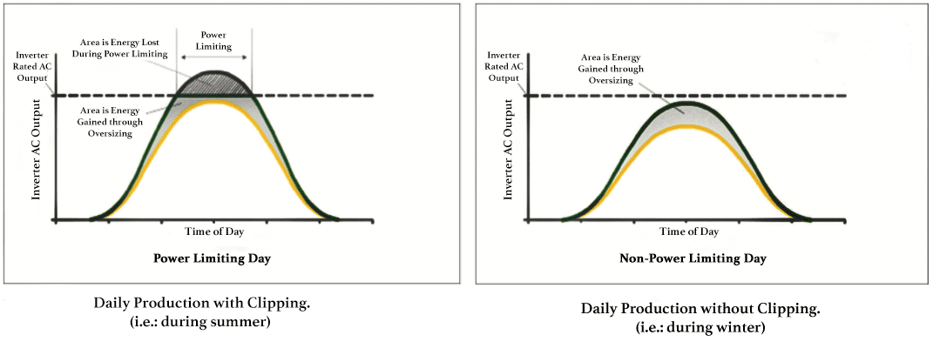
Clipping

Slide 14
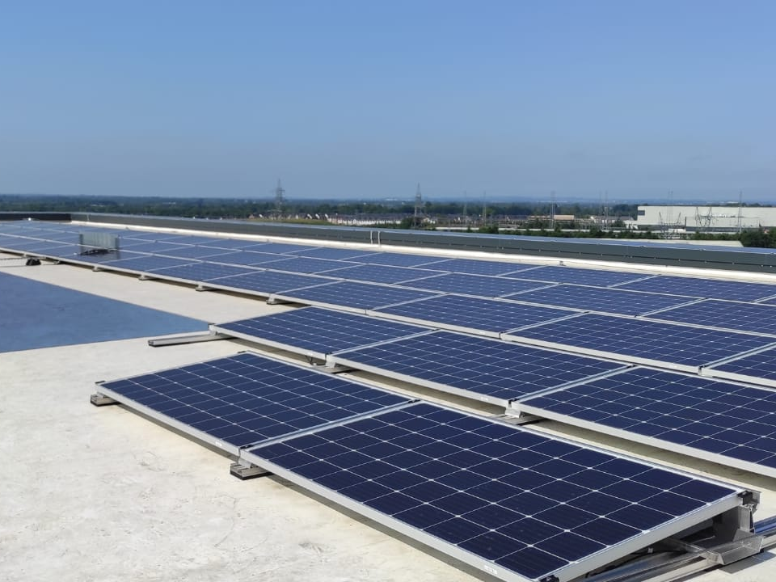
Design with safety in mind
Notes:
Over the last 3yrs increased focus on Fire safety in the all regulation. (Grenfell Tower 2017)
Panels
Cable
Inverters
Mounting systems.
Rapid Shutdown devices
G10 Panel

Slide 15
Panel Fire Rating
Standard Panels C Rated according to IEC 61730-2 / UL790
A Rated panel Bifacial Panels/Double Glass
Notes:
90% of panels C Rating due to the EVA backsheet.
Small number of installations require A rated panels. Certain insurance firms such as FM Global and certain fire certs require

Slide 16
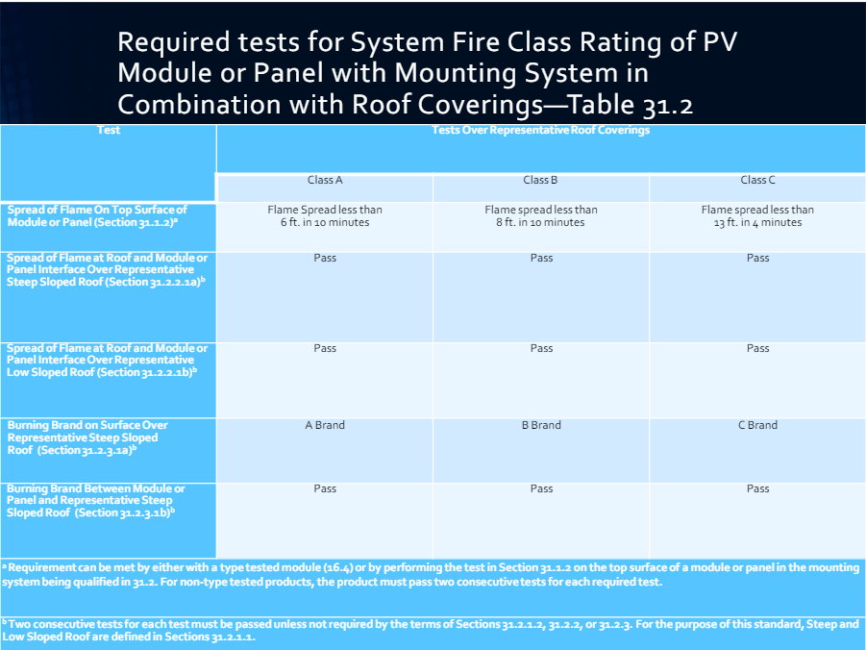
Notes:
The Panels should match the fire class of the roof or not degrade it.
Flame spread 6ft in 10minutes for A , 13ft in 4 minutes for C Class

Slide 17
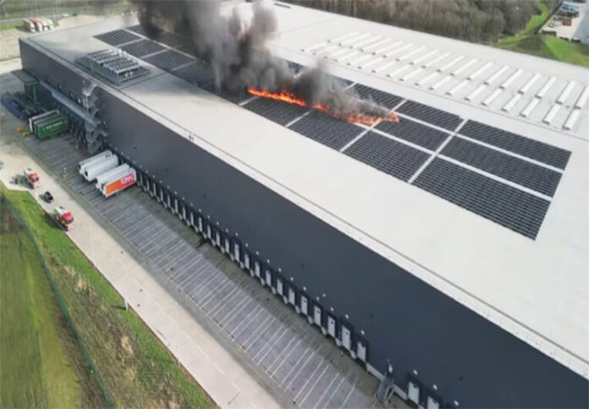
Notes:
The Panels should match the fire class of the roof or not degrade it.
Flame spread 6ft in 10minutes for A , 13ft in 4 minutes for C Class

Slide 18
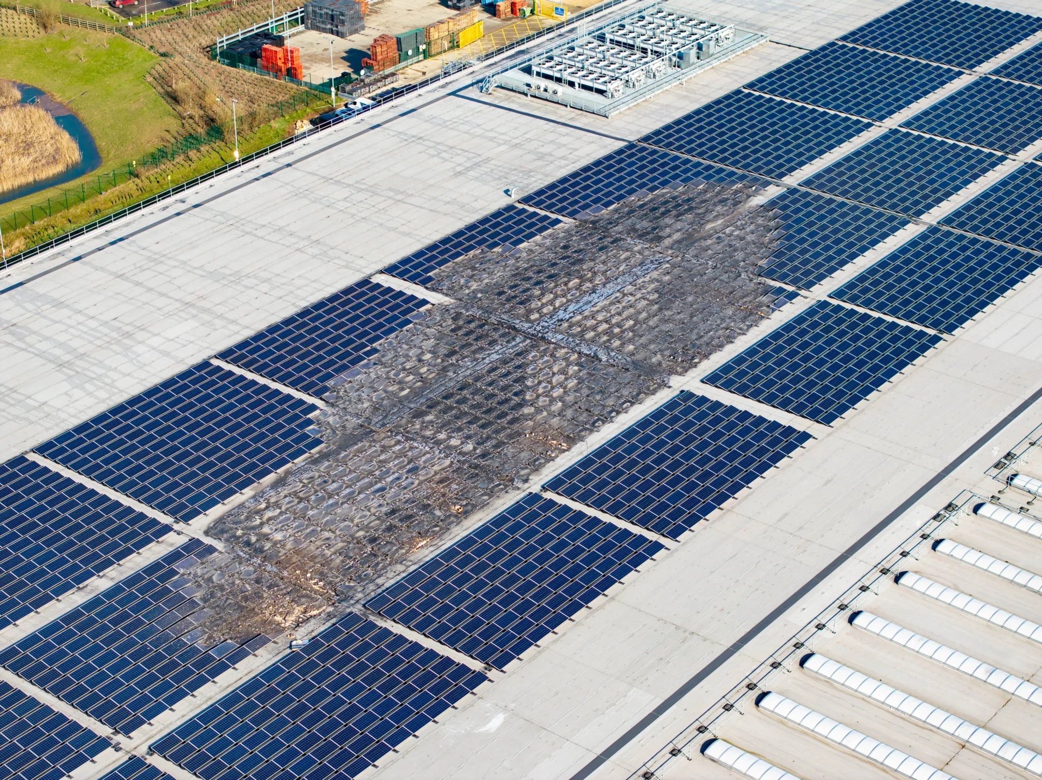
Notes:
The Panels should match the fire class of the roof or not degrade it.
Flame spread 6ft in 10minutes for A , 13ft in 4 minutes for C Class

Slide 19
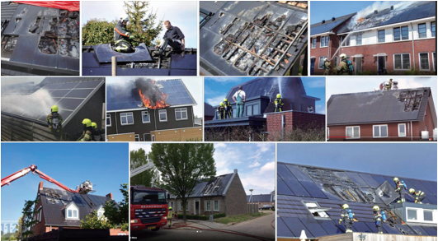
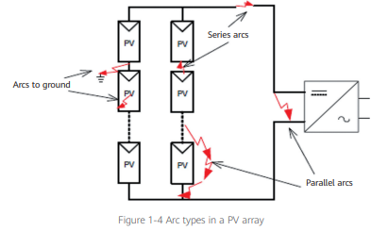
Arc Detection
Ref: Huawei Whitepaper
Notes:
Series Arc are the most common. 80%
Bad connection, Carbonisation
Damaged wires
Insulation breakdown

Slide 20
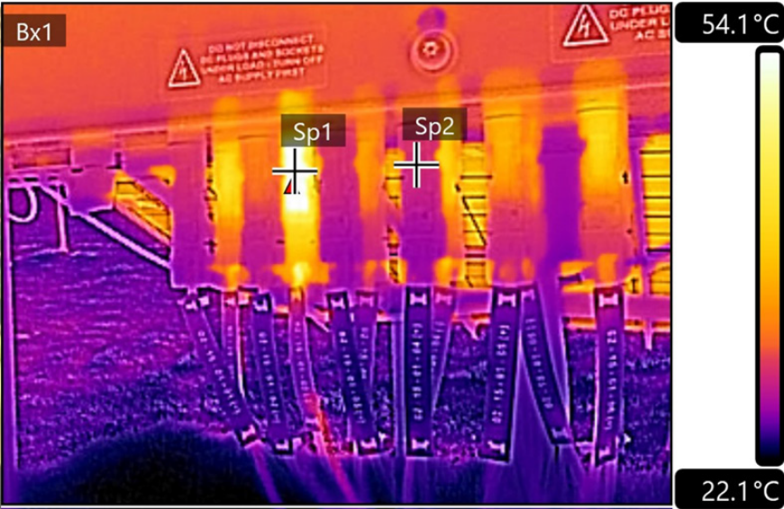
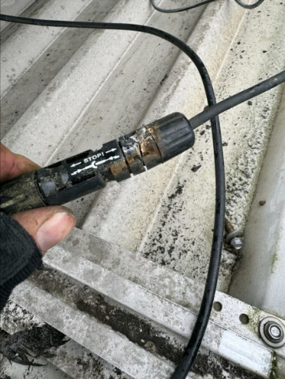
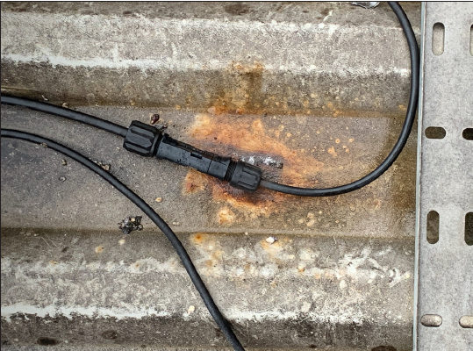
Notes:
The Panels should match the fire class of the roof or not degrade it.
Flame spread 6ft in 10minutes for A , 13ft in 4 minutes for C Class

Slide 21
ARC Fault Detection
Inverter Level Detection.
  Limited DC cable
  Possible false alerts
Module Level
  More expensive but less limitations
Notes:
Limited DC cable limited to 60mts or 200mts for a Huawei
Module Level Via optimiser or Microinverter

Slide 22
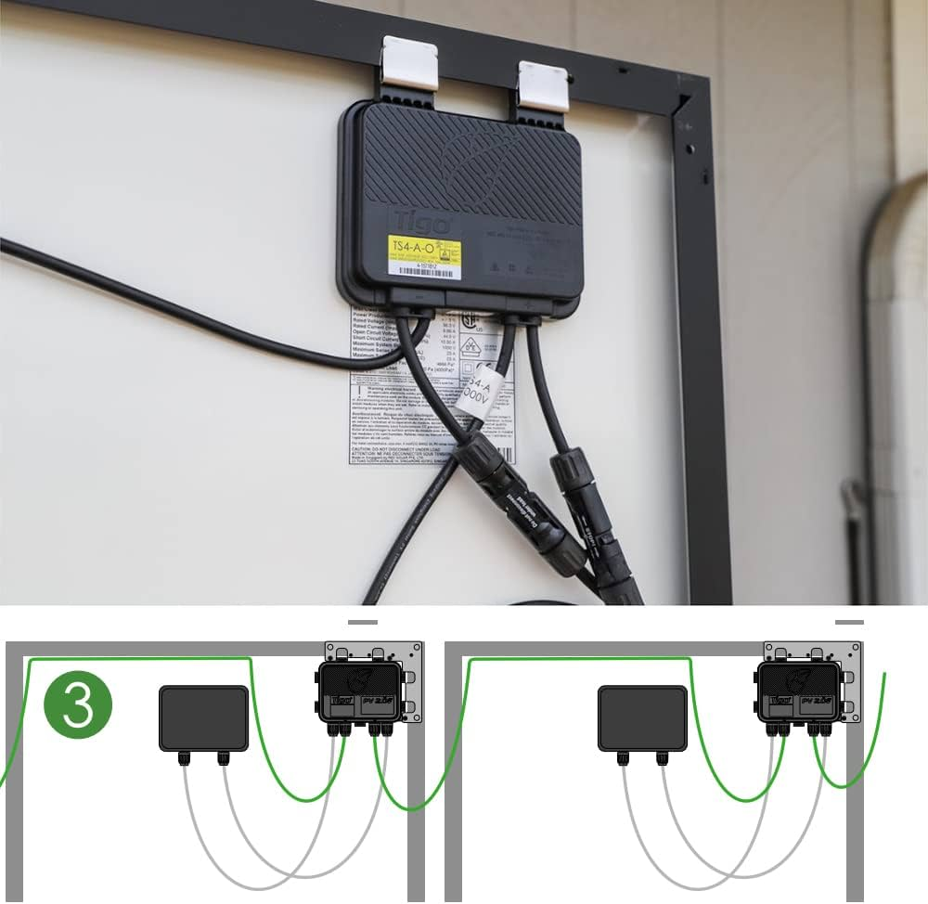
Notes:
Module level arc detection
Module level monitoring
Module level optimisation

Slide 23
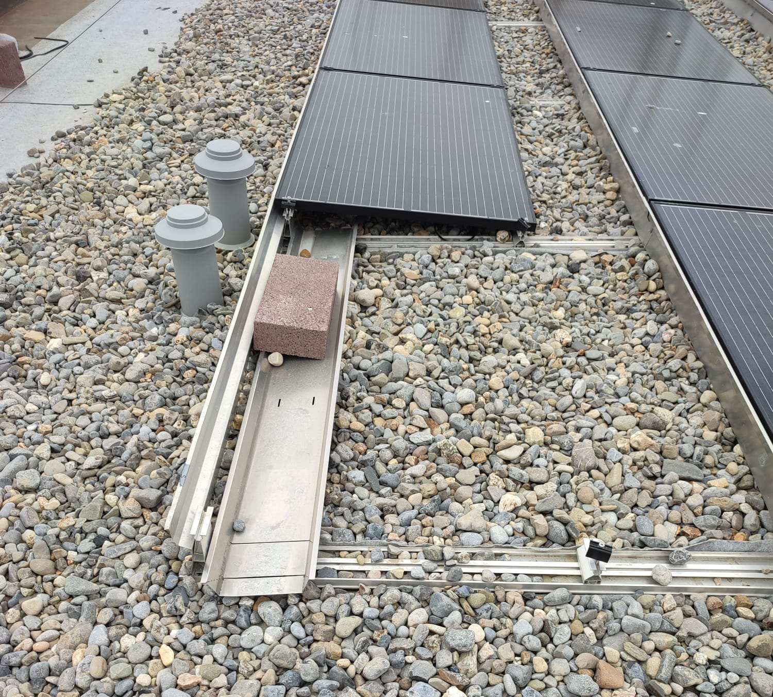
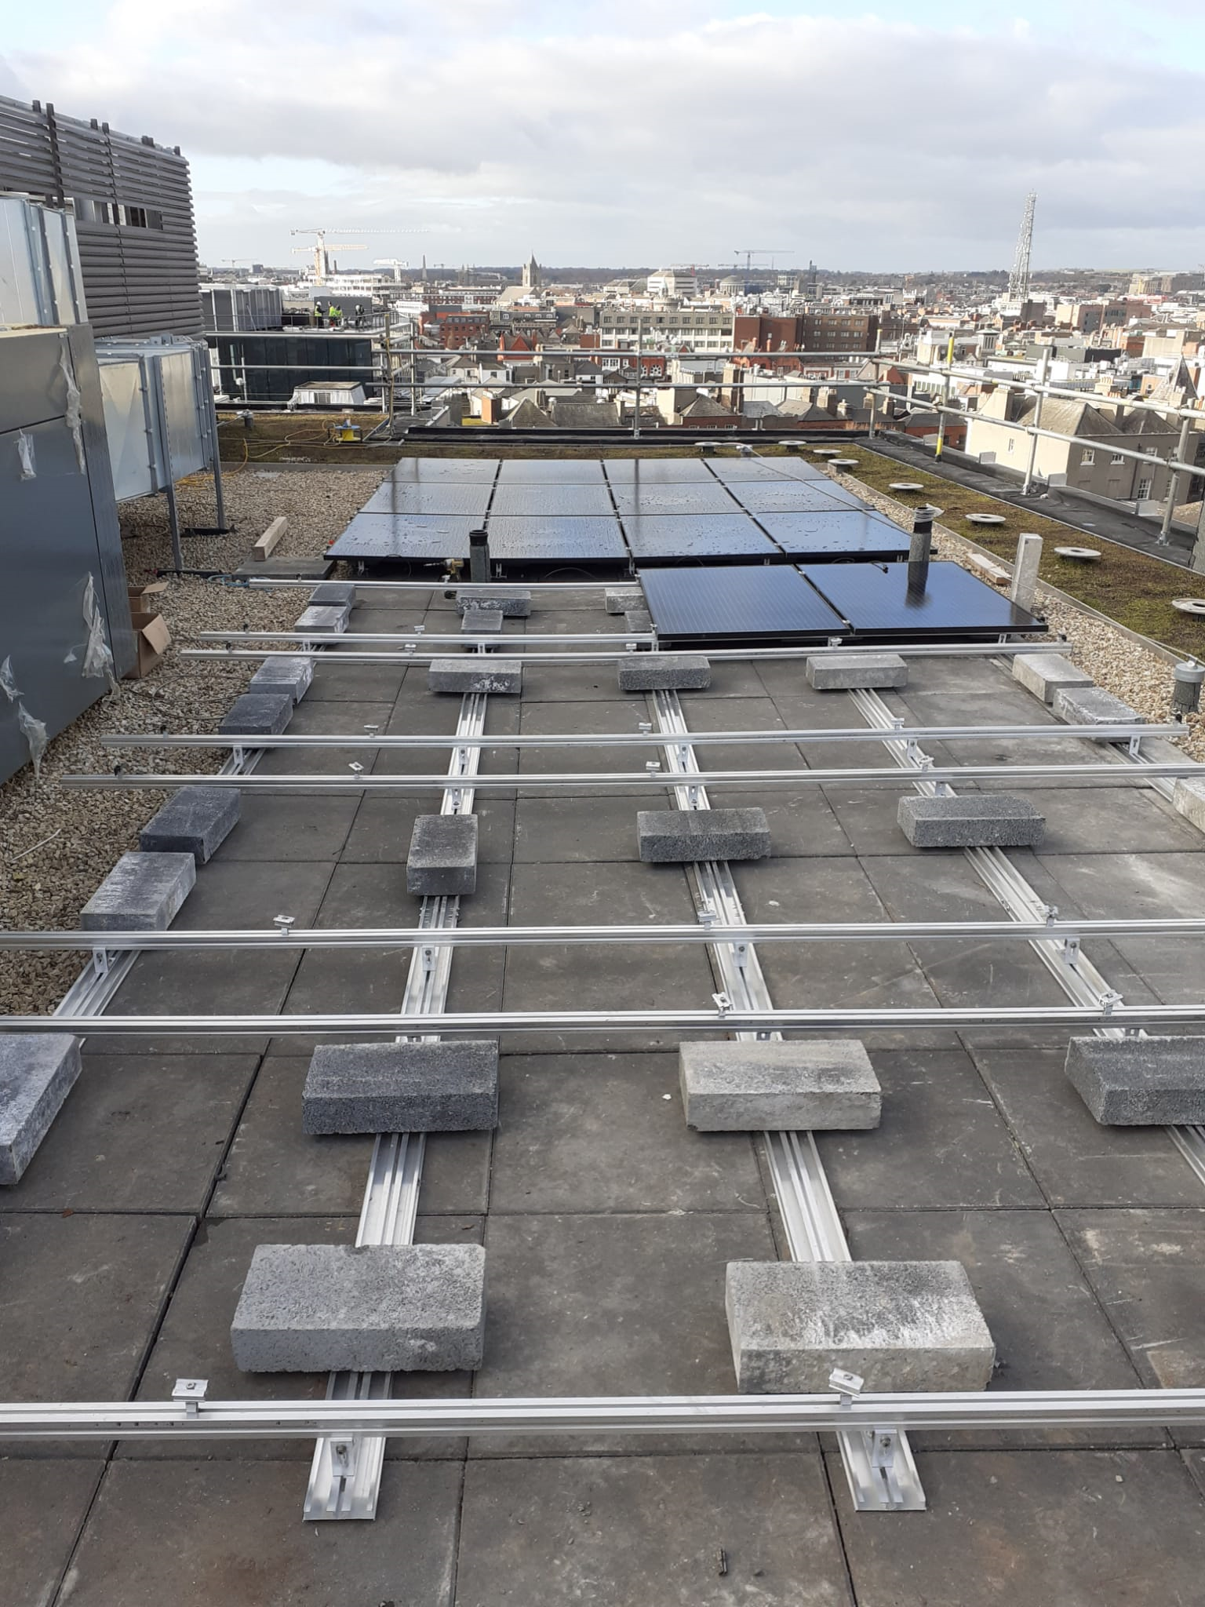
Non-combustible substrates
Notes:
Irish take a different approach on it, generally, what is done is stone ballast or paving slabs under they system.
Fire Cert Compliance:
The roof substrate under the array will be of non-combustible materials.
This requirement seems to chance from project to project and fire Marshall to fire Marshall.
Sometimes it can seem like an after thought.

Slide 24
Mounting systems
Roof type
  Flat
  Trapezoidal
  Tile slate
  Standing seam
  Membrane
Roof material
Height of the building
  Above sea level
  Above ground
Location
  Terrain
  Coastal
Standard that must comply with
  FM Global
  RC62

Slide 25
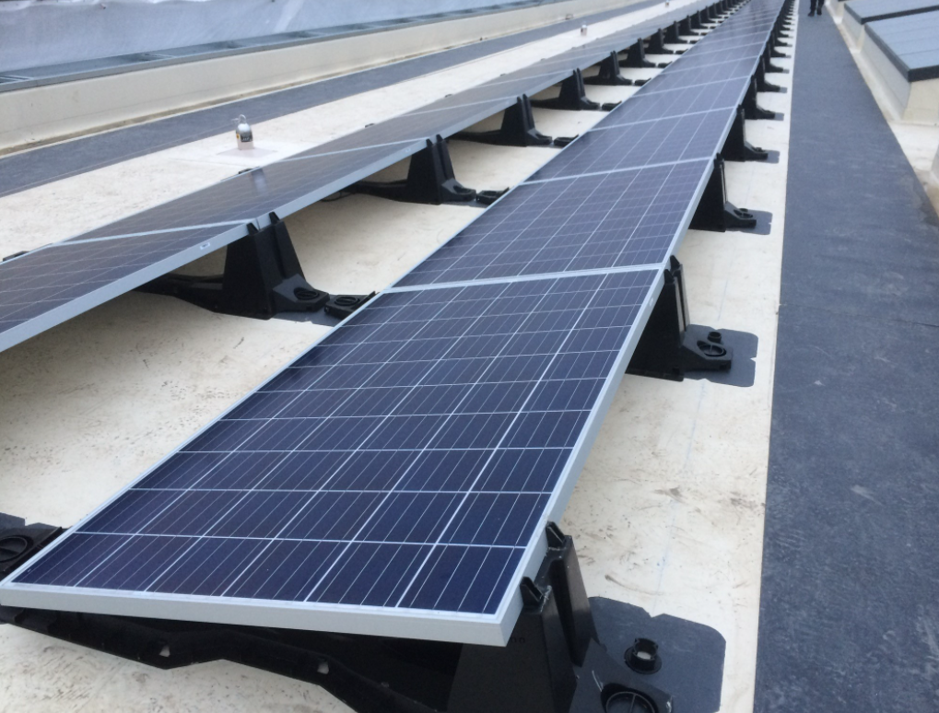
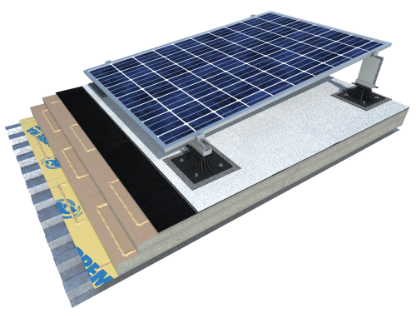
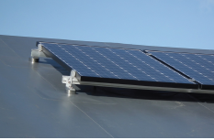
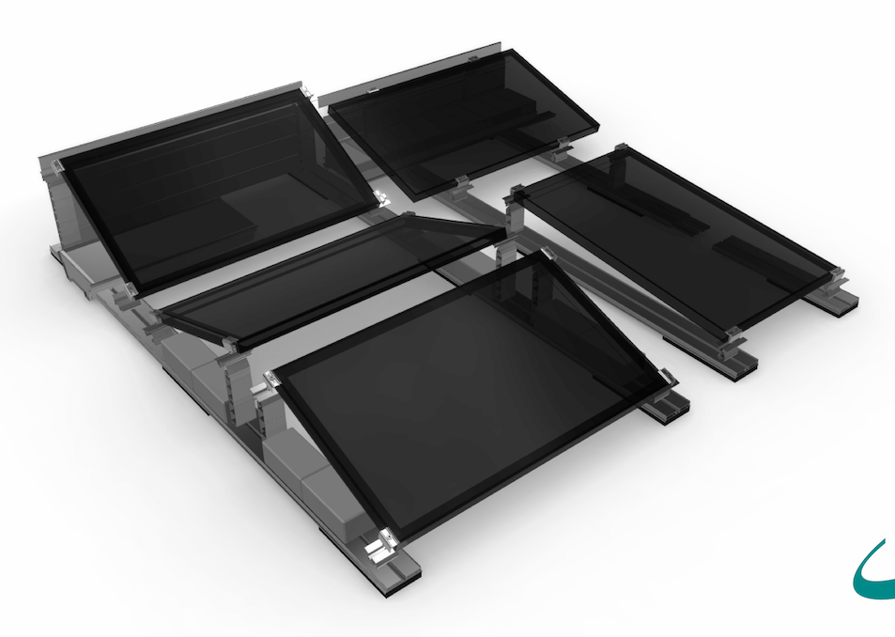
Mounting systems
Bauder
Soprema
Rooftrak
Schletter Fixgrid

Slide 26
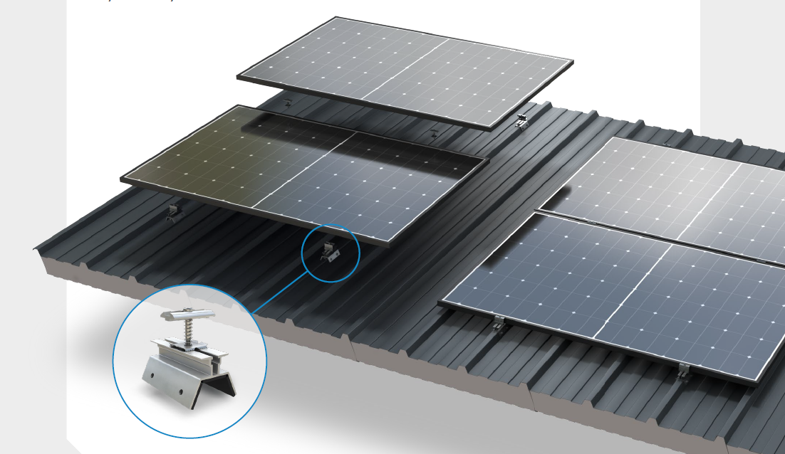
Kingspan Power Rail

Slide 27
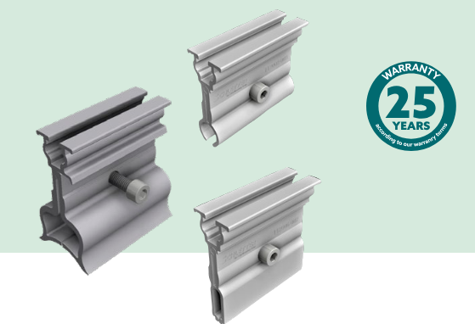
Standing Seam Roofs

Slide 28
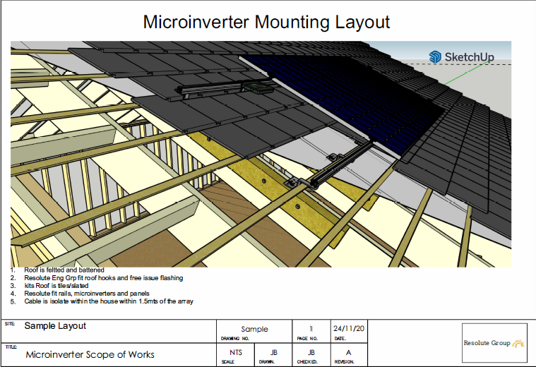
Slate and Tile Roofs
Notes:
Slate or Tile mounted systems

Slide 29

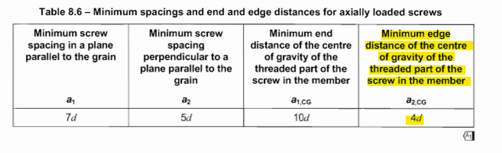
Eurocode 5: 8.7.2
Notes:
D is the outer thread diameter.
M6 screw would require a 48mm wide rafter
M8 would require a 64mm wide rafter

Slide 30
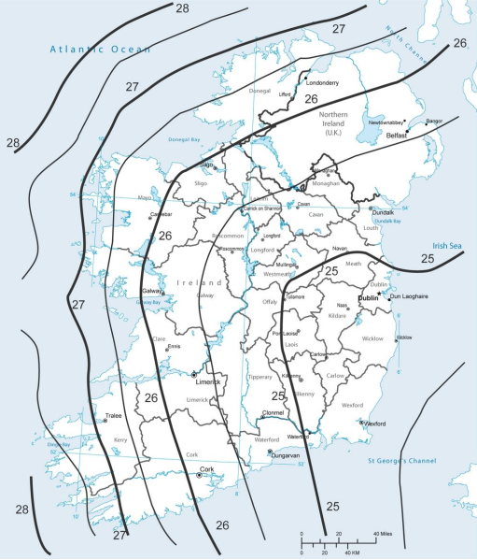
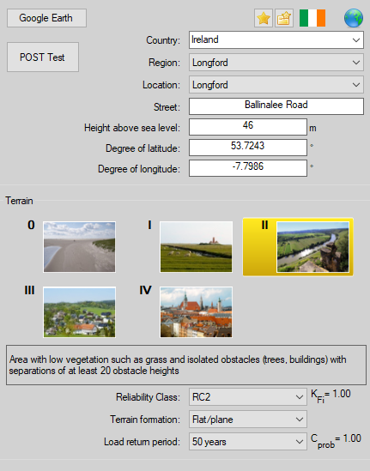
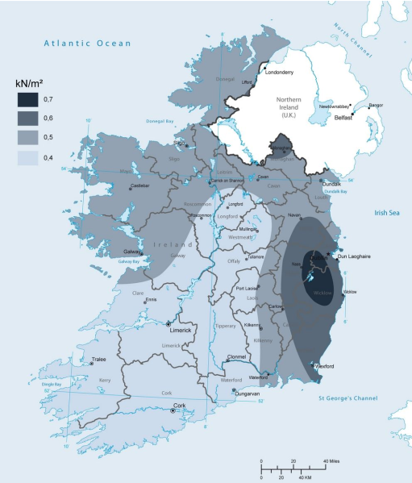
EN 1991-1-4
Irish Wind zone Map
Irish Snow zone Map
Terrain
Reliability Class

Slide 31
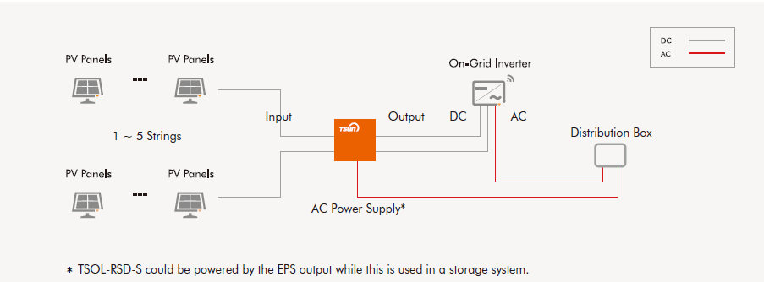
Rapid Shutdown Devices/
Fireman’s Switches
Tsun
Notes:
TGD B Part 2 5.4.5.1
Photovoltaic Panels. Where Photovoltaic (P.V.) panels are provided on buildings, provision should be made for the isolation of the panel array externally and in accordance with ET101, 2008.
Comply with Part B and I.S. 10101 Same power supply as the inverter
I.S. 10101 712.537.4.1 Emergency isolation:
Emergency Isolation should isolate the circuit from the solar PV modules into the building
Should be as close to the array as possible
Automatic isolation when the AC into the building is isolated
Automatically reconnect upon restoration of the AC Supply to the building
The Isolation of the circuit should not be operated by means of a manual isolation, a dedicated switch, push button, or other manner.

Slide 32
ESB Forms
NC6 MEC less than 6kVA 1ph or 11kVA 3ph
NC7 MEC less than 17kVA 1ph or 50kVA 3ph
NC8 MEC less than 200kVA LV or 170kVA MV
NC5 MEC from 200kVA to 2MW where generator is known
NC5a from 50kVA to 2MW where generator is not known
Notes:
NC6 2 pager
NC7 2 pager
NC5 11 pager
NC5a 4 pager

Slide 33
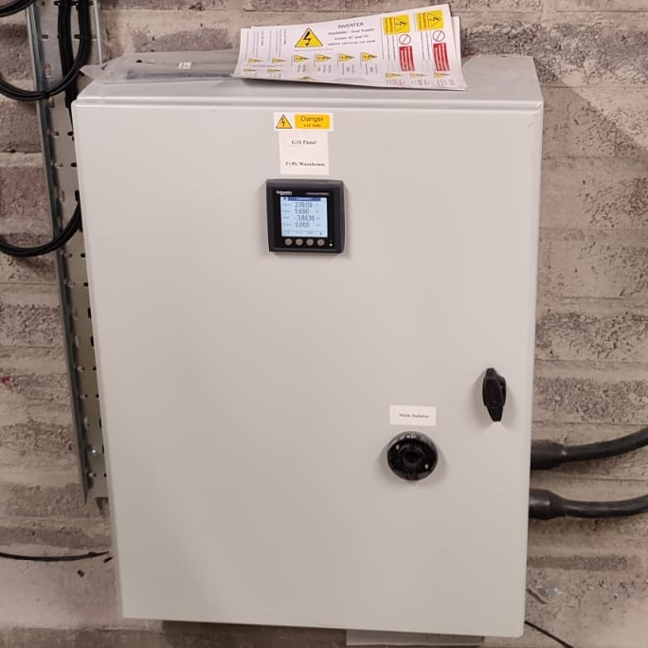
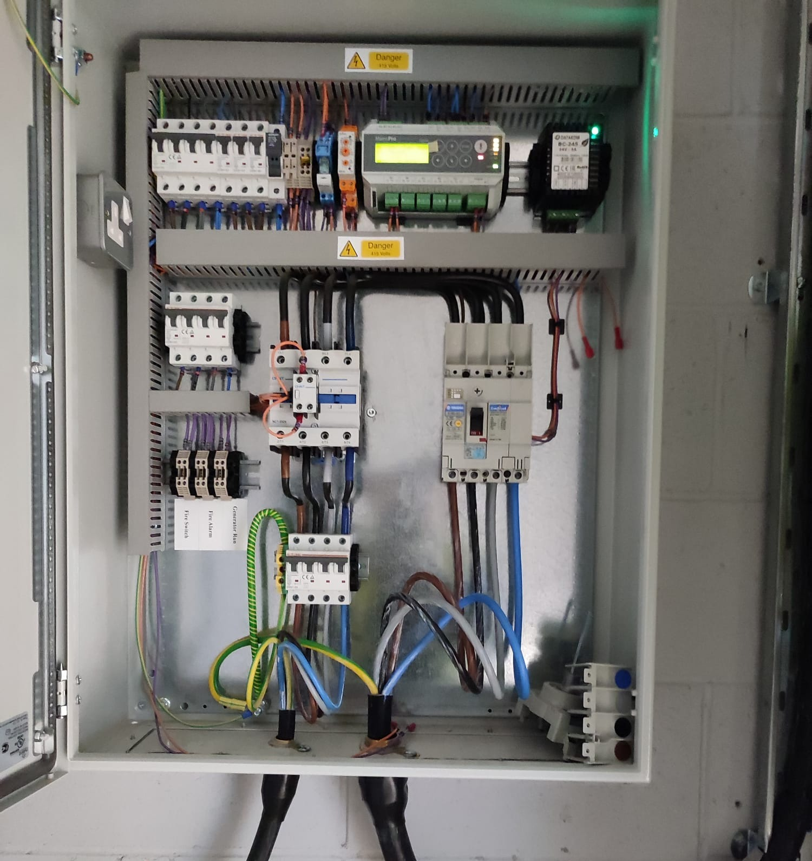
Mains Decoupling Relay Panel/G10

Slide 34
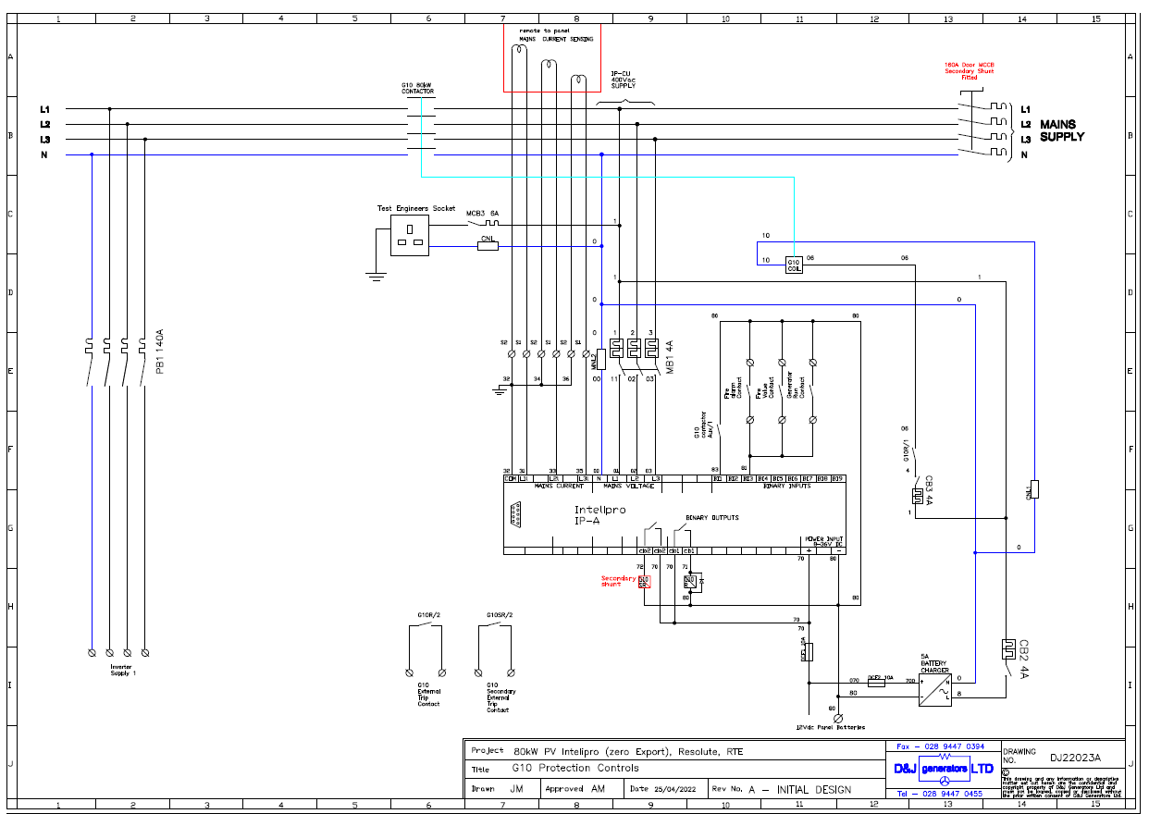
Notes:
Micro generation (NC6)
25A 6kVa single Ph
16A 11kVa 3ph
Mini Generation (NC7)
72A 17kVa single Ph
72A 50kVa 3ph
€977.85 application fee
EGIP up to 0.5MW G10 Clause (NC5)
Greater than 50kVa but less than 2MW
“Conditions Governing Connection to the Distribution System at Medium Voltage”
Installation under 200KW at Low voltage do not require Directional Overcurrent protection or (Neutral Voltage Displacement) NVD Protection

Slide 35
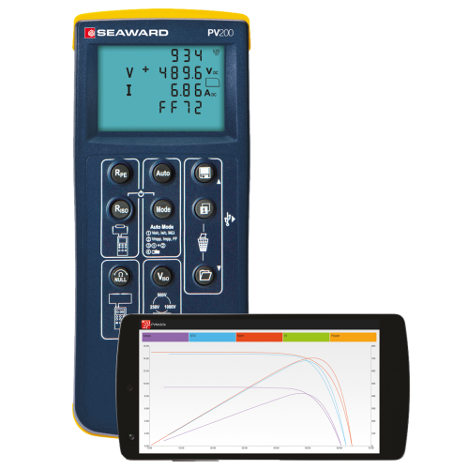
Notes:
Micro generation (NC6)
25A 6kVa single Ph
16A 11kVa 3ph
Mini Generation (NC7)
72A 17kVa single Ph
72A 50kVa 3ph
€977.85 application fee
EGIP up to 0.5MW G10 Clause (NC5)
Greater than 50kVa but less than 2MW
“Conditions Governing Connection to the Distribution System at Medium Voltage”
Installation under 200KW at Low voltage do not require Directional Overcurrent protection or (Neutral Voltage Displacement) NVD Protection

Slide 36
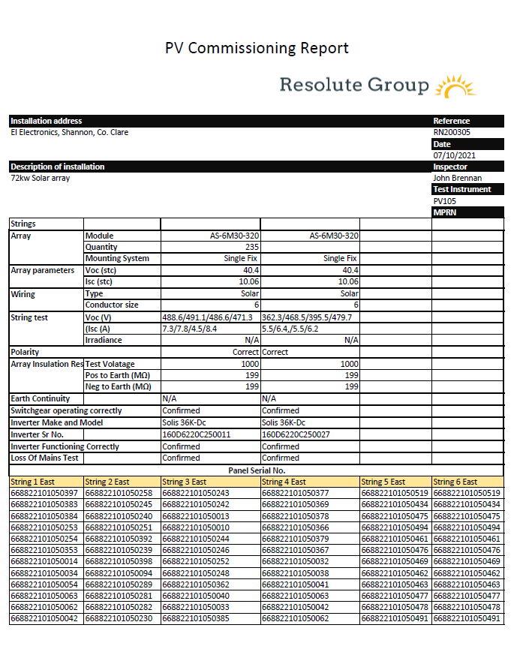
EN 62446, Annex C

Slide 37
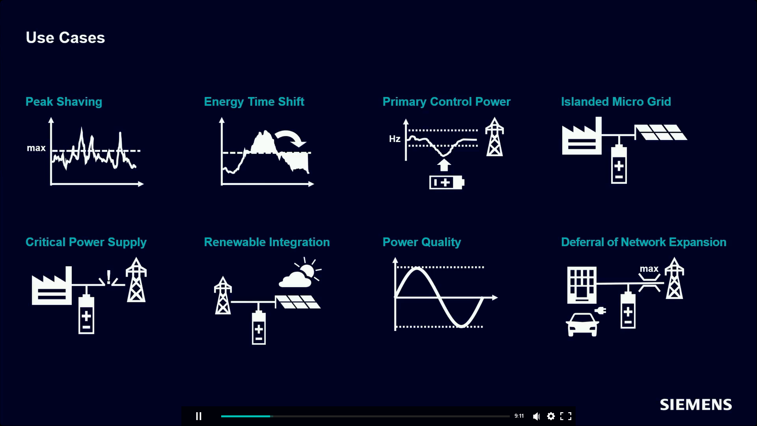
Why consider BESS?

Slide 38
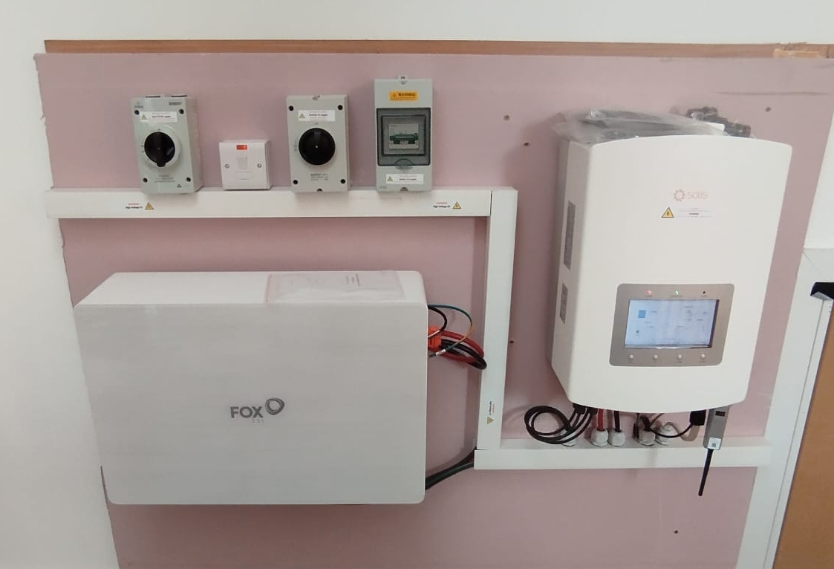
Domestic Battery Storage

Slide 39
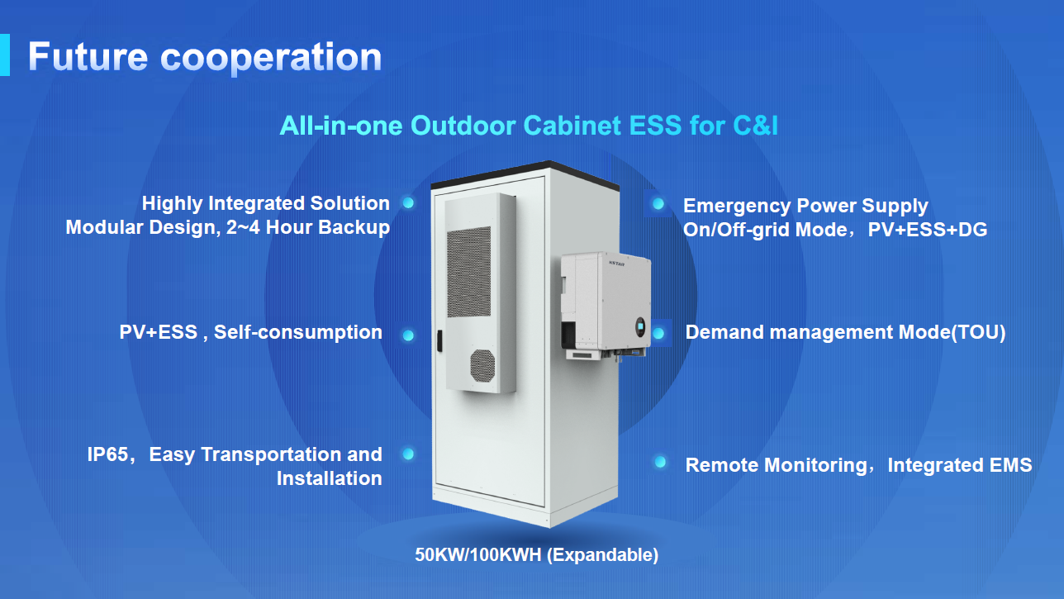
C&I Battery Storage

Slide 40
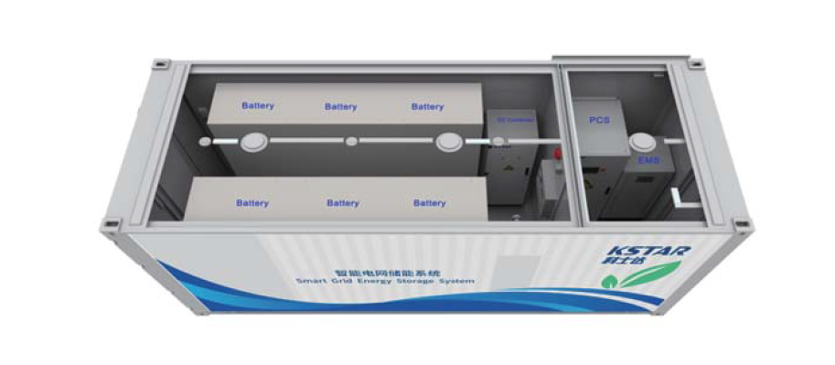
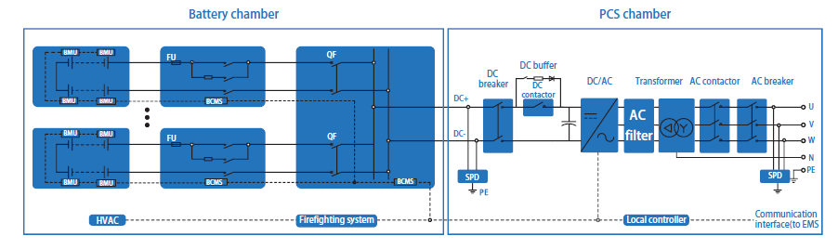

Slide 41
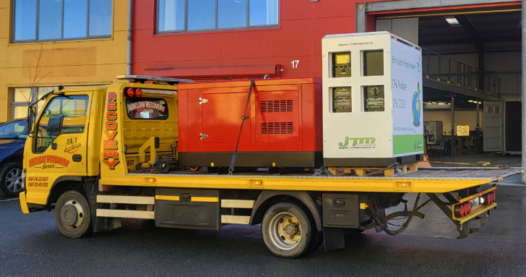
Site Solution
20kVA 40kWh Battery and 35kVA Gen

Slide 42
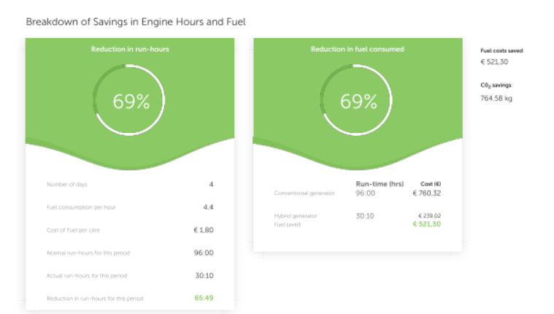
Diesel Savings

Slide 43
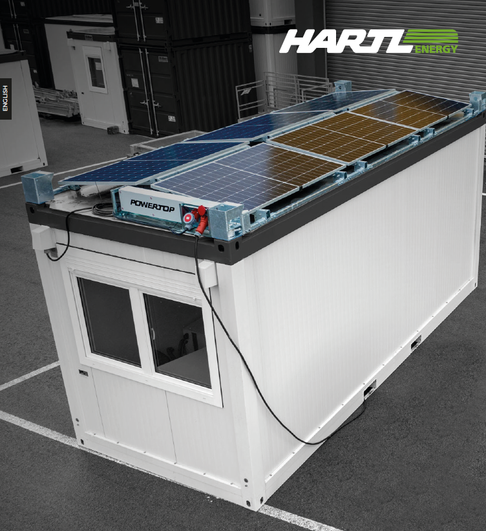

Slide 44
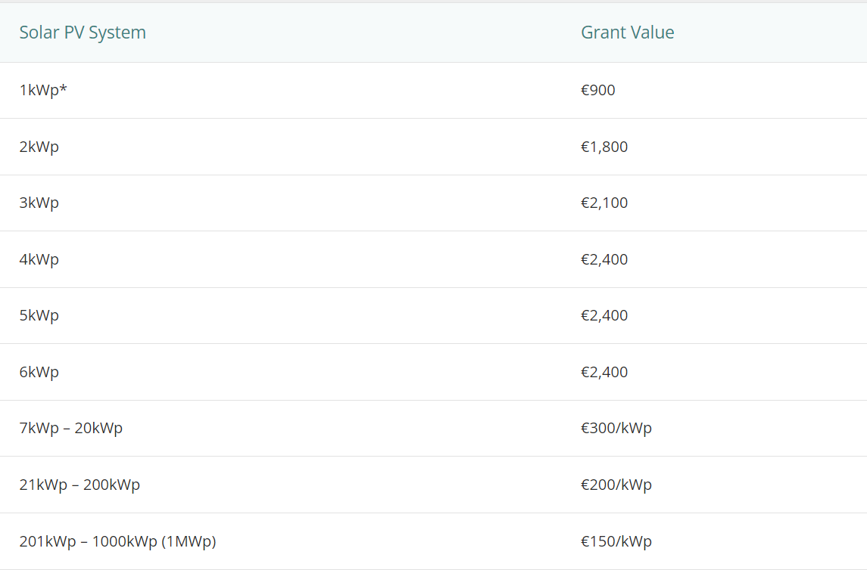
Current Supports For NDMG
Notes:
Micro-generation Support Scheme (MSS):
Domestic (homes) and non-domestic sites generating up to 5.9kW.
Grant up to €2,400 for Domestic, Schools, Sports Clubs etc
Larger, non-domestic sites (farms; business properties; community buildings; etc) generating between 6kW and 50kW.
Set payment per kWh (for surplus electricity ‘exported’ to the grid) paid by suppliers for a set period of 15 years. This is known as the Clean Export Premium (CEP) Q3 2022
Small Scale Generation Support Scheme:
Large business farms, business, factories. 50kW to 400kW
Community up to 1MW Considering Grants and or ReFit tariff in 2023
Pricing for Straight PV about €1.10/Wp at the moment.

Slide 45
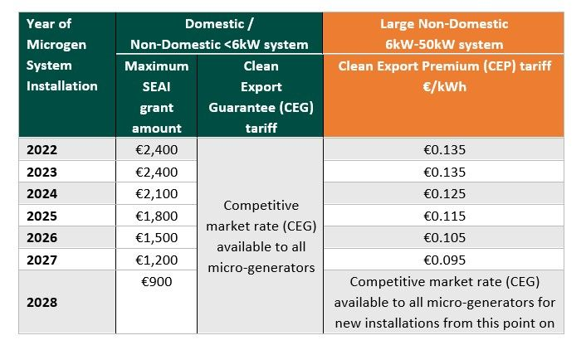
Current Supports for Domestic
Notes:
Micro-generation Support Scheme (MSS):
Domestic (homes) and non-domestic sites generating up to 5.9kW.
Grant up to €2,400 for Domestic, Schools, Sports Clubs etc
Larger, non-domestic sites (farms; business properties; community buildings; etc) generating between 6kW and 50kW.
Set payment per kWh (for surplus electricity ‘exported’ to the grid) paid by suppliers for a set period of 15 years. This is known as the Clean Export Premium (CEP) Q3 2022
Small Scale Generation Support Scheme:
Large business farms, business, factories. 50kW to 400kW
Community up to 1MW Considering Grants and or ReFit tariff in 2023
Pricing for Straight PV about €1.10/Wp at the moment.

Slide 46
Thanks
Joe.Brennan@resolutegroup.ie
086 8076840
John.Delany@resolutegroup.ie
085 1537074
Ivan.Mcfadden@resolutecivils.com
085 153 6964

