Slide 1
Target Value Delivery
Glenn Ballard
Project Production Institute
From a soon-to-be-published book titled
<Target Value Delivery of Building Projects>
Notes:
Target Value Delivery is a process for setting project value and cost targets in project definition prior to design, then steering design, construction and commissioning to those targets. This process has had several names: designing to cost, target costing and target value design. I prefer target value delivery because value is paramount and is not delivered until the project is completed.
This presentation is drawn from an upcoming book titled Target Value Delivery of Building Projects, but I believe is applicable also to industrial and infrastructure projects. However, thus far Target Value Delivery has been used primarily on building projects. Future research is needed to see if my opinion stands up to evidence.
My focus in this short presentation is on how value and cost targets are set, and various tools used to steer projects toward those targets--but only in the design phase for lack of time. The book provides more information about the history of TVD and its origin in manufacturing product development, its transition to construction with BP’s Project Andrew, and also more about how well TVD projects have performed.

Slide 2
How to set Value/Cost targets
A key presupposition of TVD is that target value can be set prior to design based on the objectives for the project. Value targets are what are needed for achieving those objectives.
A 2nd key presupposition is that an allowable cost can be set based on expected benefits from hitting value targets.
Functional Program
Functional Outcomes | Quantitative performance statements: for example, number of procedures to be performed, students to be taught, maximum response time (for buildings such as fire stations), gross operating margin
Qualitative Requirements | Adjectival quality statements: for example, grand, economical, top of the line Success measures, 100% up-time, meets needs 80% of the time, achieves LEED gold
External Conditions | Factors external to the program: for example, site conditions, existing building conditions (renovation) overall remoteness, availability of skilled labor
Irreducible Uncertainty | Uncertainty within the program requirements, for example, quantitative uncertainty, long range outcome changes. Also includes unresolved uncertainty
From a soon-to-be-published book titled
<Target Value Delivery of Building Projects>
Notes:
Let’s look now at the Target Value Delivery process, starting with How to set Value and Cost targets for a project.
CLICK
A key presupposition of TVD is that…..
CLICK
A 2nd key presupposition of TVD is that an allowable cost can be set based on expected benefits from hitting value targets.
With these we have target value and allowable cost. What’s missing is expected cost. The starting point is to develop a functional program.
CLICK
As you can see the Functional Program has these four elements, the first two of which concern what is wanted from the project—a building suitable for performing desired functions at target levels; e.g., “achieves LEED Gold”.
The third and fourth, external conditions and irreducible uncertainty, are factors that must be managed in order to deliver the first and second.

Slide 3
From Functional Program to Facilities Program
A 3rd key presupposition is that cost can be set for achieving value targets by regressing from the functional program to a facilities program capable of delivering desired functionalities within constraints, then costing that facilities program.
Facility Program
Spatial Program | Quantitative measure of number, type and size of assignable (function) rooms, allowance for non-assignable spaces (corridors, restrooms, elevators, etc.), allowance for structural area
Qualitative Requirements | Space performance narrative, measurable requirements (acoustics, lighting, etc.) and qualitative statements. Often referred to as Room Data Sheets
External Conditions | Impact of external conditions, such as anticipated foundation design, site grading, material selection
Irreducible Uncertainty | Uncertainty within the facility requirements, for example, quantitative uncertainty in un-assignable area, space utilization, extent of daylighting access, floor plate efficiency
“It is important to note that the Facility Program is still design independent - while there may be sketches or massing diagrams to support the concepts and quantification of the Facility Program, they are not intended to be design solutions.” (Ch 2)
From a soon-to-be-published book titled
<Target Value Delivery of Building Projects>
Notes:
A 3rd key presupposition is that cost can be set for achieving value targets by regressing from the functional program to a facilities program capable of delivering desired functionalities within constraints, then costing the facilities program.
The type of reasoning from function to facility is called regression, answering the question “What provides for….”; concluding from consequent to antecedent; the reverse of drawing a conclusion from accepted premisses. In research that informed the book <Target Value Delivery of Building Projects>, we found that benchmarking, simulation or most commonly a combination of the two are used to generate the Facility Program.
Benchmarking: developing estimates based on historic costs for buildings or components.
Simulation: developing estimates based on modeling what will provide desired functionalities, then costing the model.
The Facility Program also has two elements that express what’s wanted from the project: spatial program and qualitative requirements. The remaining two are the same as for the Functional Program, but specific to the facility.
“It is important to note that the Facility Program is still design independent - while there may be sketches or massing diagrams to support the concepts and quantification of the Facility Program, they are not intended to be design solutions.” (Ch 2, Target Value Delivery of Building Projects)

Slide 4
Haahtela Group’s TVD: An example of setting targets through simulation
“What’s wanted (target values) and the cost of providing what’s wanted (target cost) are determined prior to design by creating through simulation a model of the building from the voice of the customer, then costing the materials, components and services needed to construct that building.”
“The simulation model is fully detailed, buildable, and capable of supporting desired functions at desired capacities, but is not what will be constructed, leaving designers free to create designs that deliver target values within the target cost.”
From a soon-to-be-published book titled
<Target Value Delivery of Building Projects>

Slide 5
What do I want? (Project Objectives)
What is the most I’m willing to pay to get what I want?
Allowable Cost (AC)
What provides what I want?
(Functional Program)
What is the estimate of probable cost?
(Facilities Program)
Yes
No
Is EC>AC?
Yes
No
Value-Adds?
Feasible to close gap?
Revise or Stop
No
Maybe
Create and Test Project Execution Plan
No
Okay?
Yes
Set Value and Cost Targets/Fund Project
Notes:
What is wanted from the project?
What are you willing and able to pay to get what you want?
What provides what you want? Functional Program
What is the estimate of probable cost? Facilities Program
If allowable cost is greater than expected cost, the client may choose to add more value. If not, the next step is to create and test a project execution plan. If that plan is okay, the last step is to set value and cost targets and fund the project.
Going back to the comparison of expected and allowable cost, if expected exceeds allowable, then the first question is if closing the gap is feasible. If not, revise or stop the project.
If it considered possible to close the gap, create and test a project execution plan.
If the residual risk in that plan is acceptable, set value and cost targets and fund the project. If it is not acceptable, revise the plan or what’s wanted and recycle the process.

Slide 6
How is design steered to project Value/Cost targets?
“In TVD current best practice, once targets are set, cross-functional innovation teams create multiple alternatives for building systems and components using set-based design, then evaluate those alternatives against factors relevant for differentiating them, using Choosing by Advantages. The total importance of advantages of each are determined, then evaluated against their cost. If none of the alternatives is found to deliver their part of target value, design’s job is not yet done, regardless of cost. If target values are achieved, but at greater than target cost, designers continue striving for ways to achieve target values at lower cost using value engineering methods.”
From a soon-to-be-published book titled
<Target Value Delivery of Building Projects>
Notes:
Read quote
I will now explain each of the bolded methods.

Slide 7
How is Design organized on TVD Projects?:Innovation Teams
M/E/P
Building Envelope
Structure
Team Leaders
Interior/ Finishes
Site Improvements
Vertical Transp.
Landscape
Courtesy of Will Lichtig
Material Handling
Notes:
Let’s turn now to the organization of design. TVD works best when contracts allow design to be organized around cross-functional work groups for civil, structural, electrical, mechanical, building envelope, etc. To use the Structural Team as an example, it includes structural engineers, fabricators and installers. Owners, Architects and General Contractors/Construction Managers typically have representatives in each team, and teams can invite other teams to participate in meetings where issues pertinent to all are to be discussed. Further ideally each team has its own estimating capability, though that can be shared if workloads are not too great. The paper includes an example of project Innovation Teams--not shown here for lack of time.

Slide 8
Courtesy: Lean Construction Blog
Notes:
Set-Based Design is the opposite to point-based design, in which a design alternative is set early, without consulting other design disciplines and stakeholders. Let’s suppose structural engineers have selected a design for a building structure, without consulting mechanical, electrical, building envelope, construction etc. There would very likely be problems revealed once others see the proposed solution for the structure, requiring one change after another, and perhaps even, for want of money and time, failing to deliver a building fit for purpose.
To avoid that problem, Set-Based Design engages all stakeholders and disciplines in understanding expectations and requirements, then generates multiple design alternatives at system, subsystem and component levels. If none of the design alternatives look able to hit both value and cost targets, designers go back to work, looking first for design solutions from other projects. When no designs are found that deliver target value within target cost, designers invent new designs that do. The type of reasoning used in invention is called abduction. It is well understood that there are no limits to generating new solutions for all types of problems, given sufficient time--but no project is without limits on time and cost. While it makes good sense to urge designers to be creative, it helps when it is known what design problems require creativity. Identifying those as early as possible is part of deciding if a project is truly viable.

Slide 9
Choosing by Advantages
1. Identify alternatives
3. Define must and want have criteria for each factor
7. Evaluate the total importance of advantages of each alternative against its cost
2. Define factors
4. Determine the attributes of each alternative
5. Decide the advantages of each alternative
6. Decide the importance of each advantage
8. Select the alternative that offers the best value for money
Key features of CBA:
Factors are not weighted
Evaluation is deferred until there is agreement about how each alternative satisfies requirements/meets criteria
Cost is deferred until the advantages offered by each alternative can be assessed.
Notes:
Choosing by Advantages is a method for evaluating and selecting from alternatives of any kind. The first step is to generate alternatives, then (step 2) decide what factors and criteria are relevant to evaluating them(step 3) . An example from design alternatives for interior walls: One likely factor is noise level, with a must-have criterion of no more than x in decibels, and a preference (like-to-have criterion) lower than the maximum acceptable. Step 4: Alternative designs are examined to determine how each of them score against the criteria of all factors. This descriptive phase ends with step 5, when the decision makers agree on the attributes of all design alternatives. At this point, alternatives that don’t meet must-have criteria are eliminated. The remaining are ranked for their advantages relative to one another (for example, one design might offer the lowest decibel level), and the importance of advantages is agreed. Only after all this is done, cost is considered in relation to the total importance of advantages of each remaining alternative in order to find the best value for money. Some alternatives may have cost greater than target cost, so are eliminated.
Key features of CBA:
Factors are not weighted
Evaluation is deferred until there is agreement about how each alternative satisfies requirements/meets criteria
Cost is deferred until the advantages offered by each alternative can be assessed.
Key features of CBA:
Factors are not weighted
Evaluation is deferred until there is agreement about how each alternative satisfies requirements/meets criteria
Cost is deferred until the advantages offered by each alternative can be assessed.

Slide 10
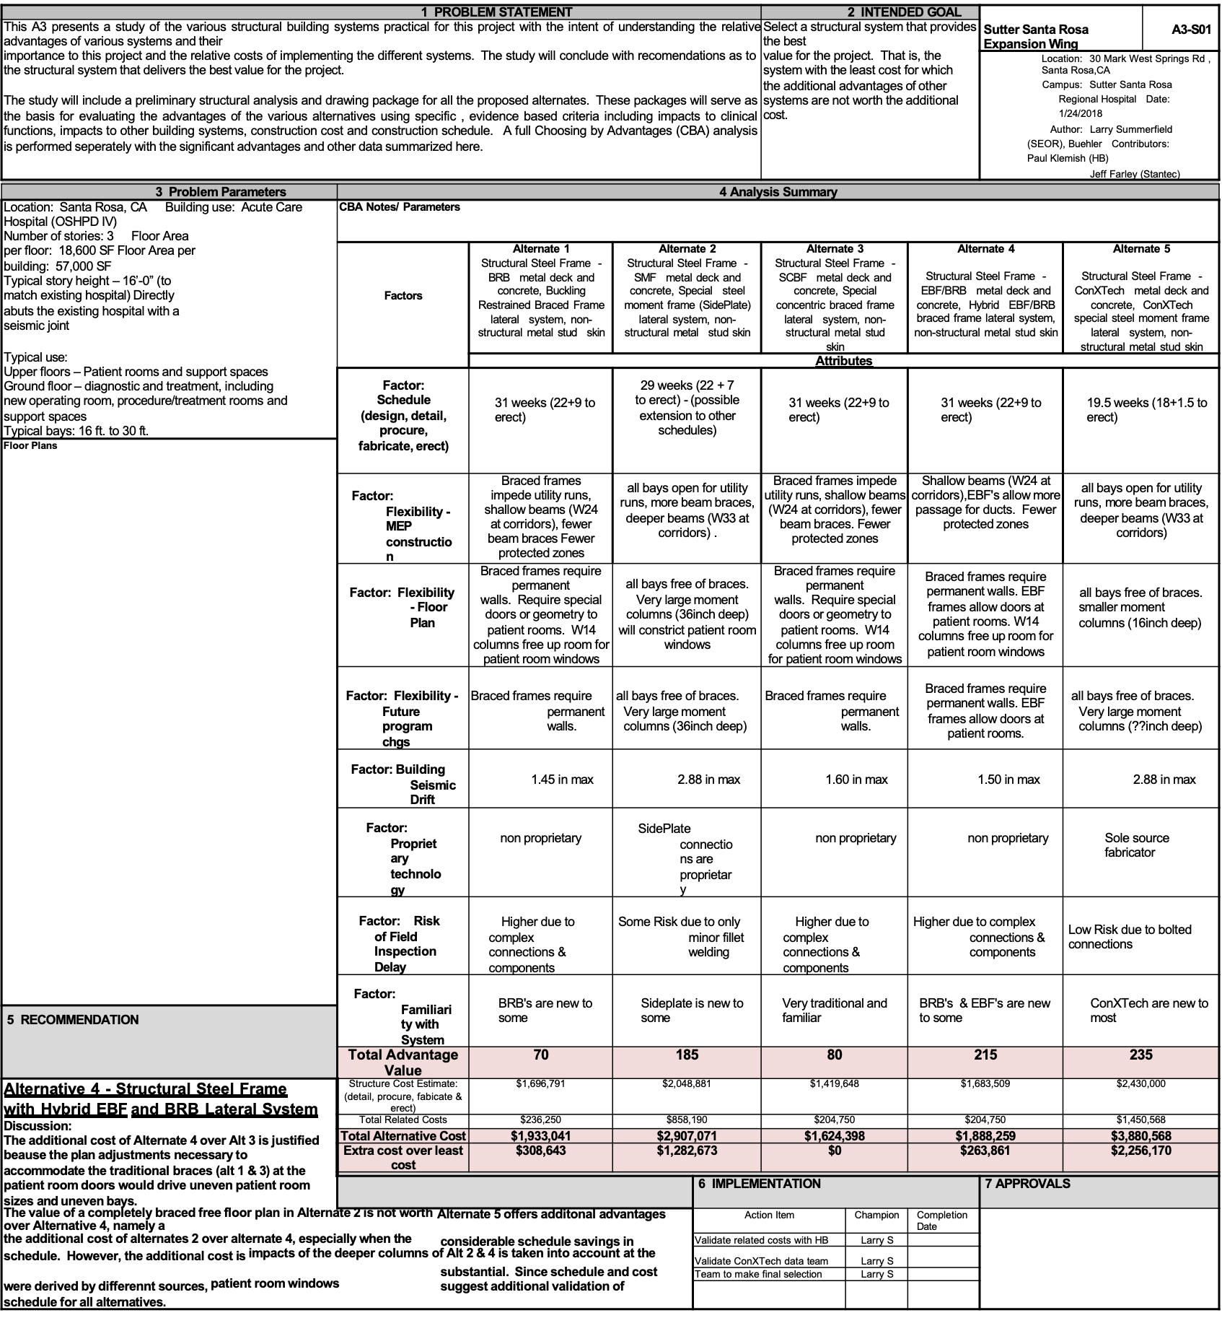
Notes:
The above is a report and recommendation to a project management team of a structural system for a hospital after evaluating alternative designs against six factors: floor plan flexibility, future program change flexibility, building seismic drift, proprietary technology, risk of inspection delay and familiarity with system. Five alternative designs were evaluated to decide on their relative advantages (value). Alternative #5 had the highest score for advantages offered at 235, with Alternative #4 in second place with 215. Because the cost for #5 was three times the cost of #4 and the additional advantage offered by #5 was only 20 out of 235 points, #4 was recommended to the Management Team—and was accepted.

Slide 11
Value Engineering and Types of Reasoning
There are 4 types of reasoning:
Deduction: drawing a conclusion from accepted premises
Induction: determining a property of a class of objects from samples
Regression: answering the question “What provides x?”
Abduction: inventing something new that may meet understood needs or create new ones.
Notes:
<Read the 4 types>
All types of reasoning are used in delivering projects, but regression and abduction play key roles in design, both of products and processes.
We’ve seen that regression is used to move from a functional program to a facility program for a building. If there are no answers to the question “What provides a desired function” (e.g., a desired level of acoustic insulation), we have to use abductive reasoning--invent and test different answers until we get one that works. Regressive reasoning is also used in analyzing breakdowns such as broken promises and injuries in search of root causes and countermeasures to those causes. Abduction comes into play when all known countermeasures have been tried and found wanting—or occasionally when a good idea spontaneously finds its way into consciousness.

Slide 12
Conclusions
Using TVD has resulted in better buildings being delivered more safely, more efficiently and faster.
Cross-functional Innovation Teams are required for effective TVD, hence Design-Bid-Build contracts are excluded.
Waste is unexploited potential for improvement. TVD provides the framework for exploiting that potential. Innovation teams, set-based design, choosing by advantages and value engineering provide the methods for realizing that potential.

Slide 13
Recommendations for Future Research
Should all projects use TVD?
Does TVD apply to industrial and infrastructure projects?
Are there project characteristics that make TVD inapplicable, e.g., level of novelty, speed of delivery?
The greater the project complexity, uncertainty and need for invention, the more intense collaboration is needed. How best to enable collaboration needs to be better understood. Shared risk and reward commercial terms in Project Alliancing and Integrated Project Delivery have proven effective in persuading the owners of participating companies to allow their employees to collaborate because doing so improves all companies financial outcomes. However there are a number of other options, including ‘fully’ integrated companies, using preferred suppliers and traditional positive and negative incentives.
Collect and analyze comparative performance data on TVD and non-TVD projects.
Notes:
Click
Re 1: We have no reason to doubt that TVD is applicable to other types of projects than buildings, but there is not so much data available. However there are some important examples. BP’s Project Andrews initiated the development of Project Alliancing, a form of shared risk and reward contracting frequently used for public infrastructure projects in Australia. Also Heathrow Airport’s Terminal 5 used TVD very successfully.

Slide 14
Thank you for your attention. I look forward to your questions and comments.

Slide 15
Conditions that promote creativity (abduction)
Clear goals
Innovation is valued
Sufficient time is provided
Autonomy in how to achieve goals
Collaboration and discussion
Koskela and Ballard (2021):Shifting the focus of discussion: from cost (under) estimation to cost reduction. In 29th Annual Conference of the International Group for Lean Construction (pp. 43-52).
Notes:
<Read the bullet points>

Slide 16
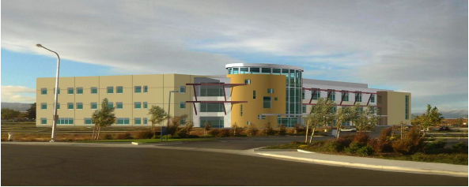
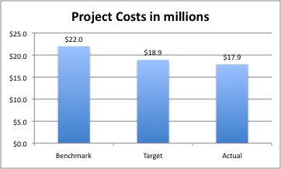
Sutter Fairfield Medical Office Building
Target Cost was set 14% below Benchmark
Actual cost was 10% below Target and 19% below Benchmark
The owner declared the project fit for purpose
©2009 The Boldt Companies
Notes:
In 2006, Sutter Health began a number of pilot projects applying TVD and other Lean methods. In 2012, their Chief Architect, Dan Conwell, gave a presentation on their first 22 projects, which culminated in this medical office building shown here. All 22 projects were completed within budget and time, and all were fit for purpose. Those results persuaded Sutter Health to use Lean Project Delivery and TVD for design and construction of their acute care hospitals.
CLICK
This medical office building would have cost $22 million based on actual cost of previous such buildings. Sutter Health set a target cost of $18.9 million and completed the project for $17.9 million.
CLICK
Here’s how that works out in percentages.

Slide 17
TVD in Mfg.: Ford 1910s, Volkswagen 1930s, Value Eng in WWII, Designing to Cost (US Dept of Defense) 1960
Orlando Florida’s “Integrated Project Delivery” 1999
UK: Cost Planning 1951
Lean Product Development 1963
BP’s Project Andrews 1991
Project Alliancing 2000
Integrated Project Delivery 2004
Finland: Haahtela Group 1980
USA: Lean TVD 2002
Notes:
Let’s consider now the question where TVD came from. In our research we found various forms of TVD. All set targets prior to design and then proactively steer projects toward those targets. We almost certainly did not find all of them and suspect that conditions that demand radical performance improvement have given rise to many other forms of TVD in different times and places. What we did find occur first in manufacturing’s product development: In the 1910s, the valued properties and the expected costs of Henry Ford’s automobile factories and the cars they produced were set prior to design. That also happened in Volkswagen’s development of the first VW bug in the 1930s. The demands of war-time production led to the development of value engineering methods in the U.S. and likely in Japan and Germany as well. Post-WWII, the United States Dept. of Defense initiated Designing to Cost, and in the early 1960s Toyota adopted value engineering and TVD in its product development process under the name “target costing”.
Click
The next chapter takes us from manufacturing to construction. In the early 1950s, quantity surveyors in the UK developed cost planning. Reading the early publications of James Nesbit and Ivor Seeley make it clear that cost planning is a form of TVD, albeit with a strong focus on cost management.
Click
Independently Professor Yrjana Haahtela, working for the Finnish government, led development of a form of TVD in Finland to award cost subsidies to institutional projects such as schools.
Click
Lean TVD emerged in the early 2000’s in the United States—an application of Toyota’s target costing to construction, which was also influenced by Haahtela’s work.

Slide 18
Notes:
Advocate Aurora Outpatient Center Cost Normalization Tool
Moving from 2012 to 2016 and counting, here’s a complex multi-year program for designing and delivering various types of out-patient facilities for AdvocateAurora Health in the United States. It offers the advantage of continuous improvement from project to project, as can be seen in the table in the upper right corner. Measured cost savings year to year: 2016-0.5%, 2017-9.2%, 2018-18.9%, 2019-14.5%. Estimated cost savings for 2020 and 2021 were forecast and later confirmed at 16% and 18%. And beyond cost, there is continuous improvement in the fitness for purpose of facilities and their speed of delivery.
Chapter 7 provides detailed explanation how different project players use TVD to deliver their projects. Chapter 7.1 reports on TVD use by a Norwegian public owner. 7.2 reports on TVD use by HDR Architecture and Engineering headquartered in Nebraska. 7.3 reports on TVD use by AECOM in the United States. 7.4 reports on TVD use by the Boldt Companies, a general contractor and developer headquartered in Wisconsin. 7.5 reports on TVD use by DPR Construction headquartered in California.

Slide 19
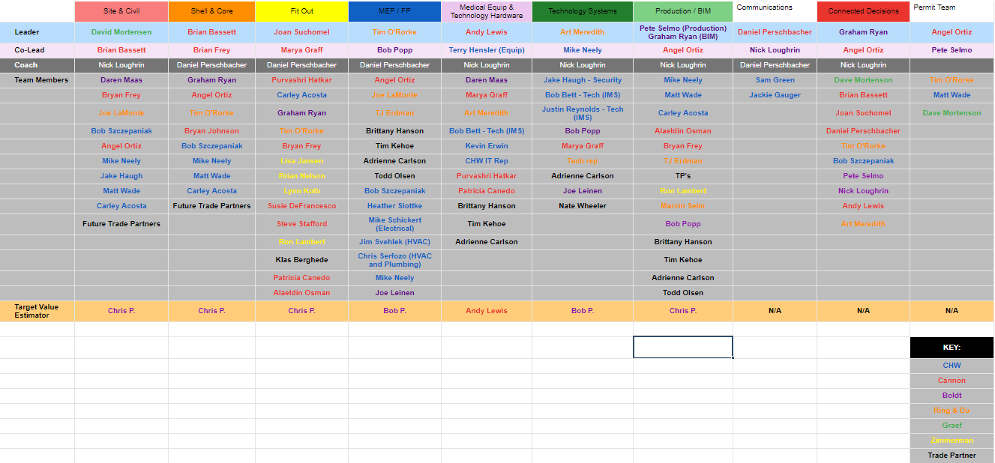
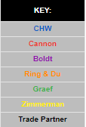
Courtesy of the Boldt Companies
Notes:
Here is an example of a project design phase structured in ’innovation teams’, courtesy of the Boldt Companies. At the top we see the different teams; e.g., Site/Civil and Shell and Core. Below are the leaders and co-leaders of each team, coaches for each team, team members and finally Target Value estimators. The companies to which these individuals belong are color coded as shown in the KEY in this order: Client, Architect, General Contractor, Mechanical-Electrical-Plumbing Specialty Contractor, Structural Engineer and a supplier of pre-fabricated products. The leader of the Shell and Core team is from the architect and that team includes people from the Client, the General Contractor and the MEP Engineer.

Slide 20
Should all projects set stretch goals-targets at levels beyond what has previously been achieved?
Doing so is to apply Taiichi Ohno’s advice: ‘Lower the river to reveal the rocks’. That risks putting a hole in your boat, so stretching should be done carefully and with close attention to project constraints. It is important, however, to be mindful of balancing the effort with the outcome and matching it to the sufficiency of the outcome. For highly repetitive projects, simple, rapid benchmarking can be perfectly adequate. For truly novel projects, it may be more important to evaluate the unknowns, and to engage in targeted research to eliminate the uncertainty that can be eliminated, and to bound or mitigate the uncertainty that cannot be eliminated but can be managed.
Whether to set stretch goals and how much to stretch is a matter of assessing if the risk is acceptable. If there is no additional risk, that matter is mute. If the benefits to be gained are substantive and the risk of achieving them acceptable, why not pursue stretch goals? More systematic assessment of the potential for innovation in product or process design informs that decision-making. Where might innovation efforts be focused? Is there sufficient time and money in the project to enable such efforts to be successful? Developing more systematic assessment of the potential for innovation in product and process design is a matter for future research-see recommendation 3 below.
Notes:
Read only the title!!
Doing so is to apply Taiichi Ohno’s advice: ‘Lower the river to reveal the rocks’. Doing so involves risking putting a hole in your boat, so stretching should be done carefully and with close attention to project constraints. It is important, however, to be mindful of balancing the effort with the outcome and matching it to the sufficiency of the outcome. For highly repetitive projects, simple, rapid benchmarking can be perfectly adequate. For truly novel projects, it may be more important to evaluate the unknowns, and to engage in targeted research to eliminate the uncertainty that can be eliminated, and to bound or mitigate the uncertainty that cannot be eliminated but can be managed.
Whether to set stretch goals and how much to stretch is a matter of assessing if the risk is acceptable. If there is no additional risk, that matter is mute. If the benefits to be gained are substantive and the risk of achieving them acceptable, why not pursue stretch goals? More systematic assessment of the potential for innovation in product or process design informs that decision-making. Where might innovation efforts be focused? Is there sufficient time and money in the project to enable such efforts to be successful? Developing more systematic assessment of the potential for innovation in product and process design is a matter for future research-see recommendation 3 below.

Slide 21
Introduction
UC Berkeley’s P2SL Target Value Delivery Research Group was launched in 2016 to persuade the building industry to adopt TVD wherever feasible, and to strive to make it feasible where it isn’t. This objective was broken down into nine research questions, and book chapters devoted to answering each of them:
What are the essential characteristics of TVD? (Ch 1)
How are project value/cost targets set? (Ch 2)
How are projects steered toward value/cost targets? (Ch 2)
What is the history of TVD’s development? (Ch 3)
Has TVD demonstrated success in setting and steering to value/cost targets? (Ch 3 and 8)
What estimating methods and tools are used in TVD? (Ch 4 and 5)
How is uncertainty managed in TVD? (Ch 6)
How is TVD used in practice? (Ch 7)
What is the relationship between TVD and Lean? (Ch 8)
The book has 8 chapters written by a total of 22 authors, including examples how different project players do TVD: owners, cost consultants, designers, and general contractors.

