Slide 1

[INSERT WEBINAR TITLE]
WEBINAR TITLE | Built To Innovate
PRESENTER | Ross O Colmain
ORGANISATION | Enterprise Ireland
DATE | 31st August 2022

Slide 2


Slide 3
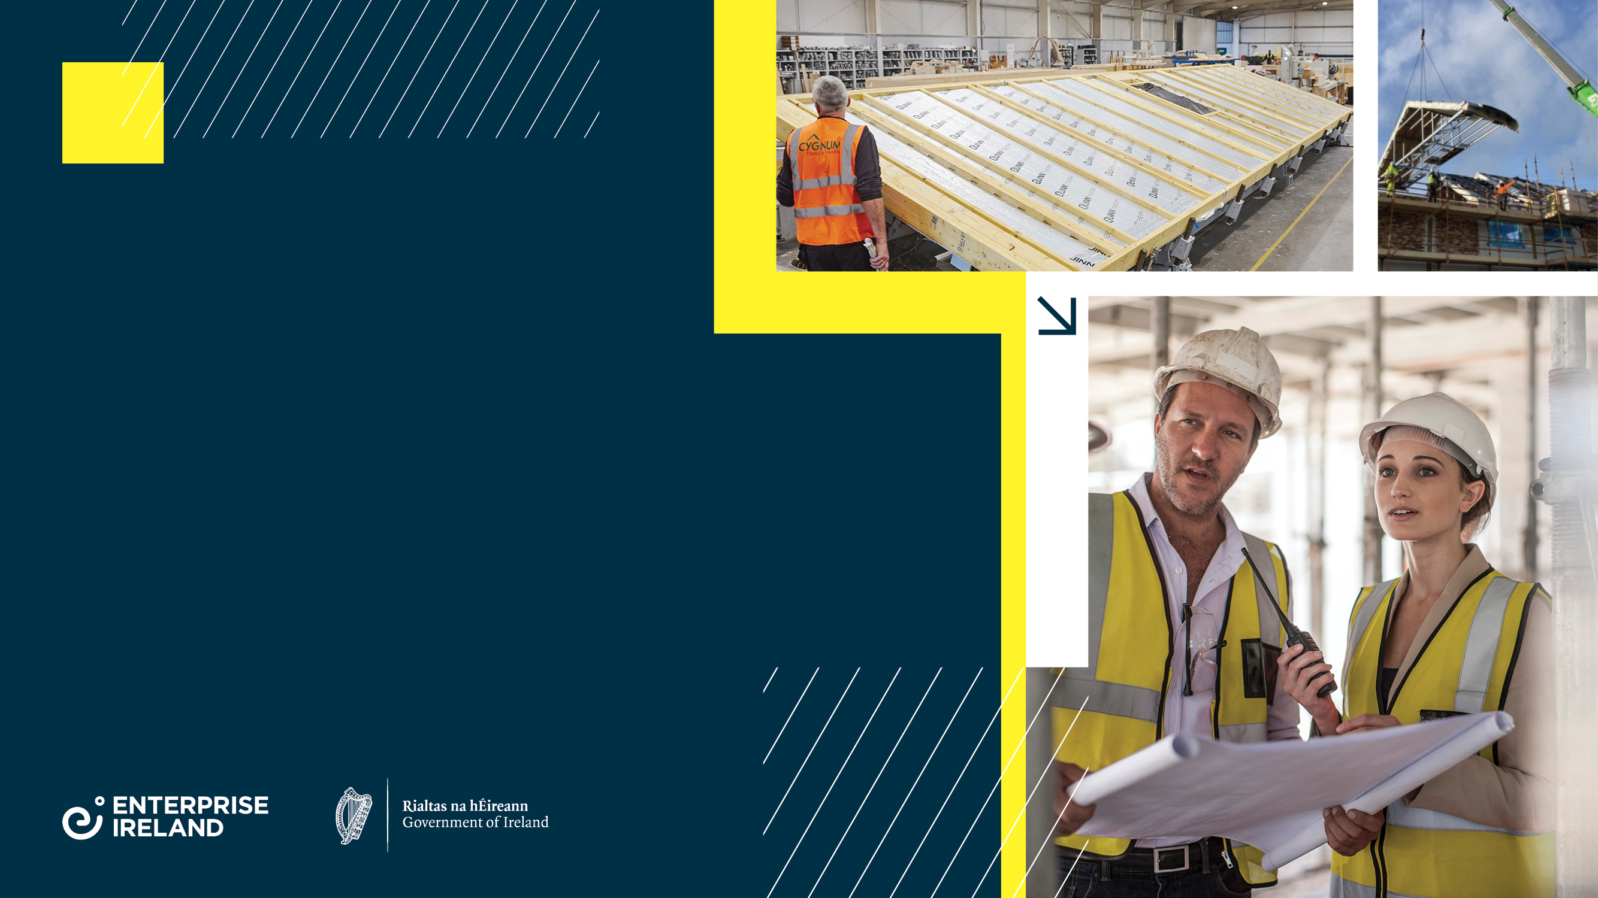
BuiltToInnovate
An initiative of Enterprise Ireland
under the Housing For All Plan.
LCI Webinar August 31st
Ross O Colmain
Manager, High Tech Construction and Housing

Slide 4
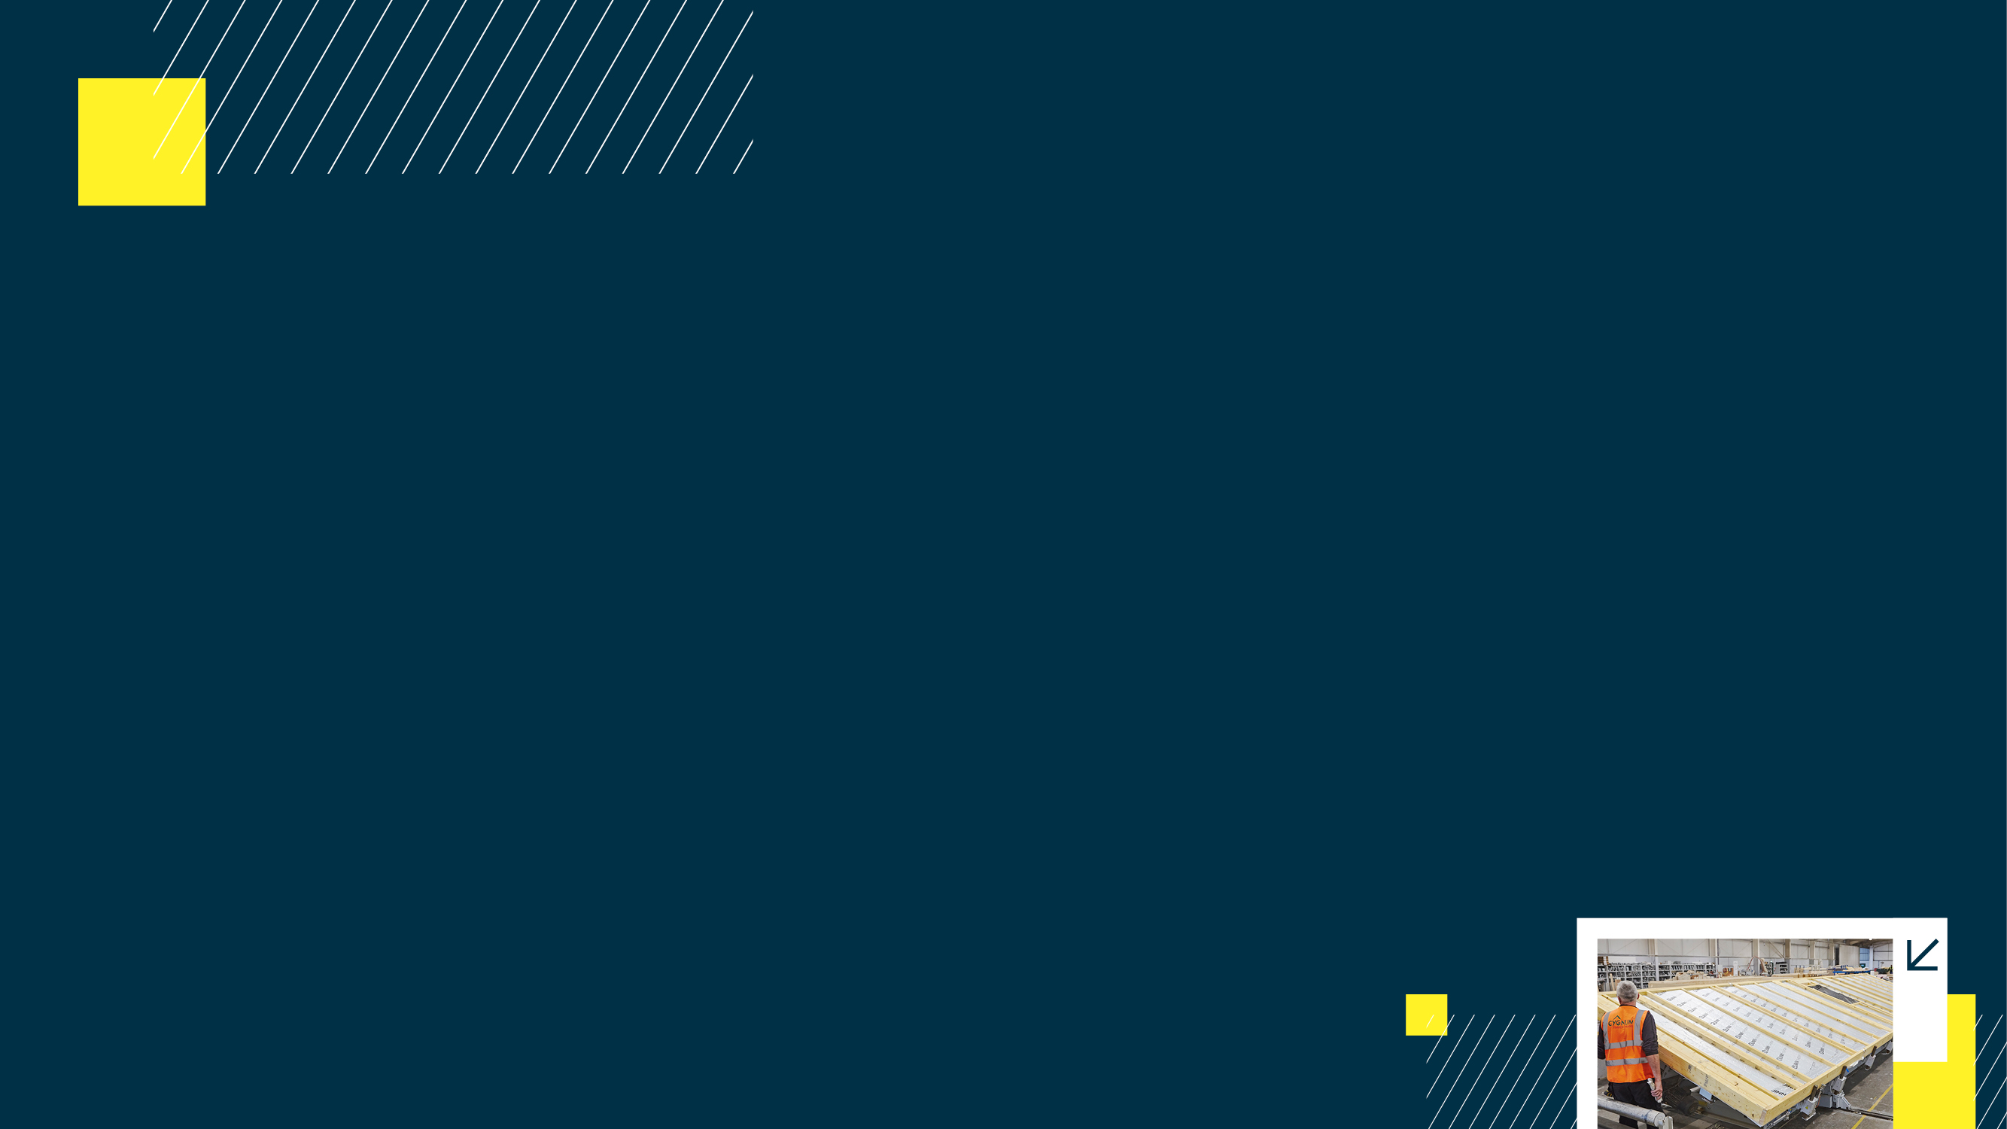
Enterprise Ireland High Tech Construction Activity
Portfolio of 450 export orientated companies classified as construction products, services or timber.
Exports of €2.9bn, up 24% in 2021. Major markets are the UK and Northern Europe
Clients in these sectors employ over 40,000
Export focus is high tech construction into UK, and Eurozone markets. Highly successful in international data centre contracts.
Industry challenges that Enterprise Ireland is supporting the sector on include: Digitalisation, Sustainability, Industry 4.0 adoption.
BuiltToInnovate
An initiative of Enterprise Ireland
under the Housing For All Plan.

Slide 5

Housing For All – Enterprise Ireland
In Pathway Five, under the heading ‘Achieve Economic Sustainability’, there are two clear actions for Enterprise Ireland:
Expand Agency Mandate: Expand the role of enterprise agencies to include funding and supports for innovation and productivity related projects in the domestic residential construction sector, with funding for research, innovation and productivity to be provided, commensurate with the scale of construction in the domestic economy and in compliance with State Aid rules.
Construction Technology Centre: Ensure that the construction sector is supported to innovate, in terms of construction methodology and technology. The Technology Centre being established by Enterprise Ireland with NUIG led consortium will have a focus on residential construction.
BuiltToInnovate
An initiative of Enterprise Ireland
under the Housing For All Plan.

Slide 6

Housing for All - Objective
“Everyone in the State should have access to a home to purchase or rent at an affordable price, built to a high standard and in the right place, offering a high quality of life.”
BuiltToInnovate
An initiative of Enterprise Ireland
under the Housing For All Plan.

Slide 7
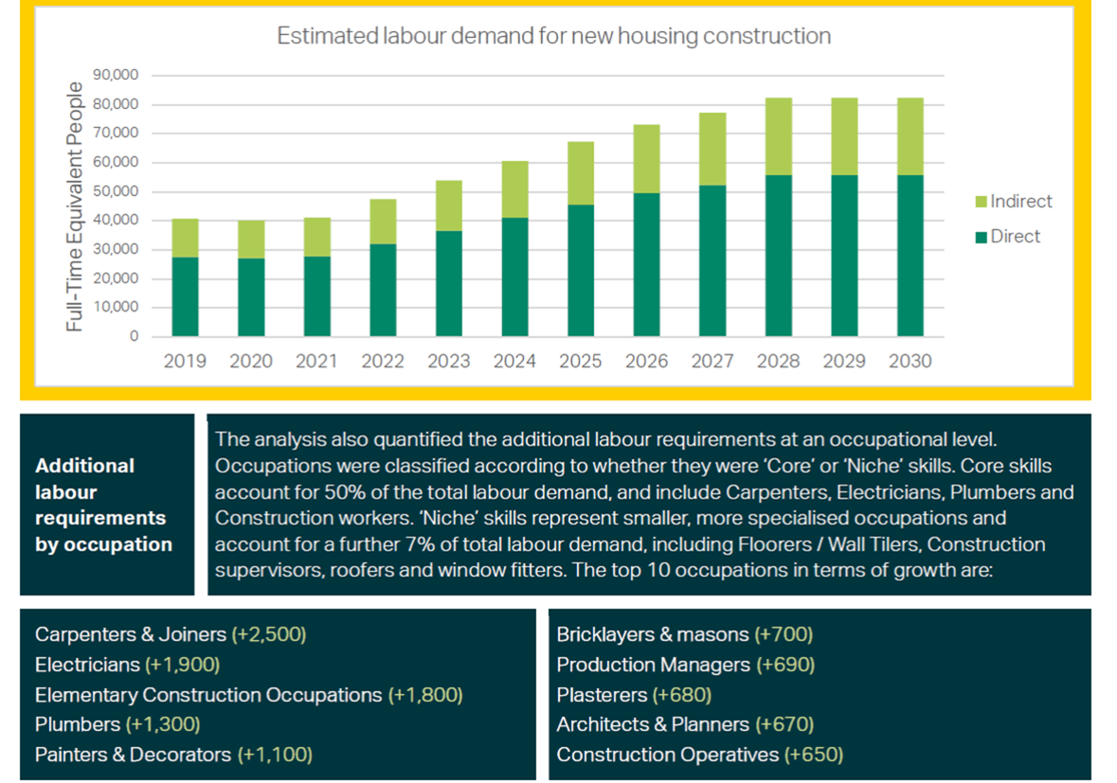
Labour and Sector Capacity
BuiltToInnovate
An initiative of Enterprise Ireland
under the Housing For All Plan.

Slide 8
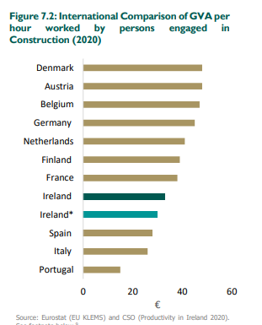
Costs and Productivity – The Opportunity
BuiltToInnovate
An initiative of Enterprise Ireland
under the Housing For All Plan.

Slide 9
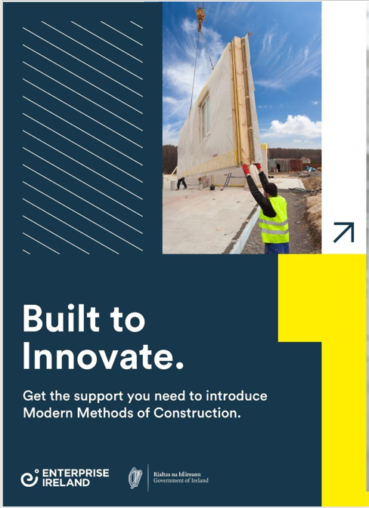
One to one conversations with 25+ companies responsible for more than 6,000 units per annum.
Labour #1 constraint for growth.
Funding for:
Productivity training
New technology tools
Innovation in offsite manufacturing
BuiltToInnovate
An initiative of Enterprise Ireland
under the Housing For All Plan.

Slide 10
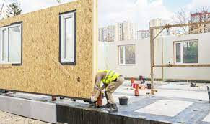
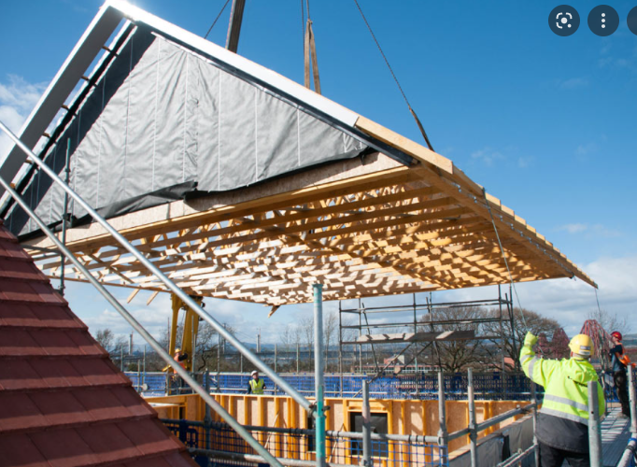
Innovation
Increasing Pre Manufactured Value to drive on site efficiencies and reduce labour requirement.
Availability of wet trades is seen as a major issue.
Interested in developing an aesthetically pleasing cladding solution.
Approached one of the Institutes of Technology to conduct research.
Innovation
Introductory | Explorative | Mid size | Transformative
Innovation Voucher | Exploring Innovation | Agile R&D/Inno PartnerS | RDI Grants
Complexity and Level of Funding
BuiltToInnovate
An initiative of Enterprise Ireland
under the Housing For All Plan.

Slide 11

Productivity – Digitalisation by a General Contractor
Multi-faceted efficiency drive.
Migrate paper to digital, increase BIM usage, expanded use of project management software.
To date has seen large yield from PM software – increased efficiency and quality.
Productivity – Lean and Digital
Introductory | Explorative | Mid size | Transformative
Lean Start/ Digital Discovery | Lean Plus | Digital Process Innovation | Op Ex/ Lean Transform
Complexity and Level of Funding
BuiltToInnovate
An initiative of Enterprise Ireland
under the Housing For All Plan.
This Photo by Unknown author is licensed under CC BY-ND.

Slide 12

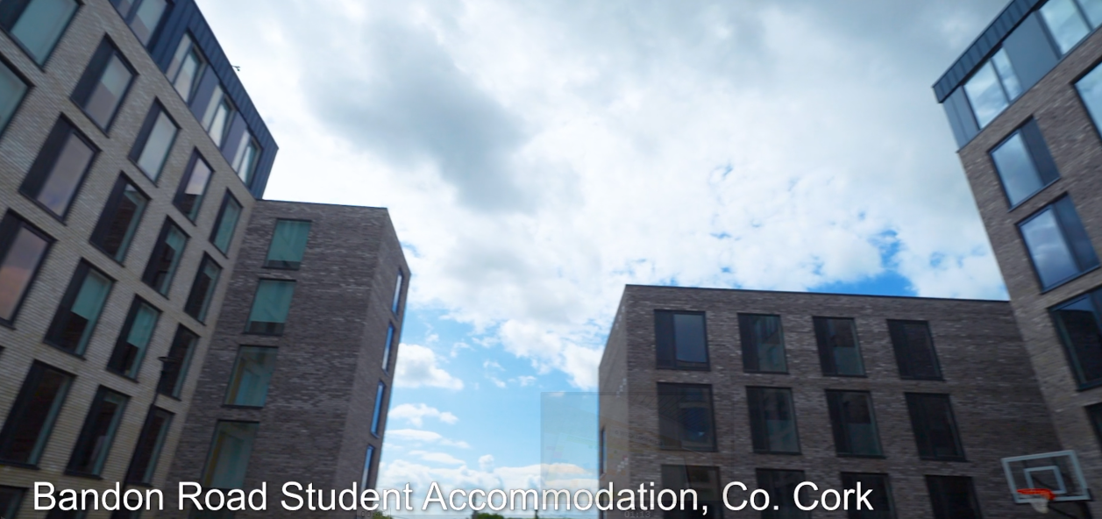
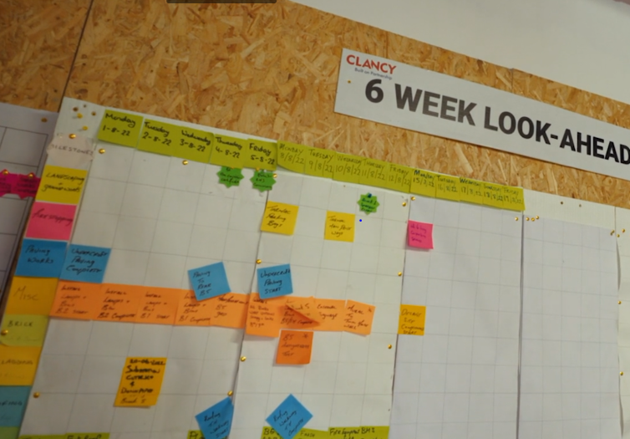
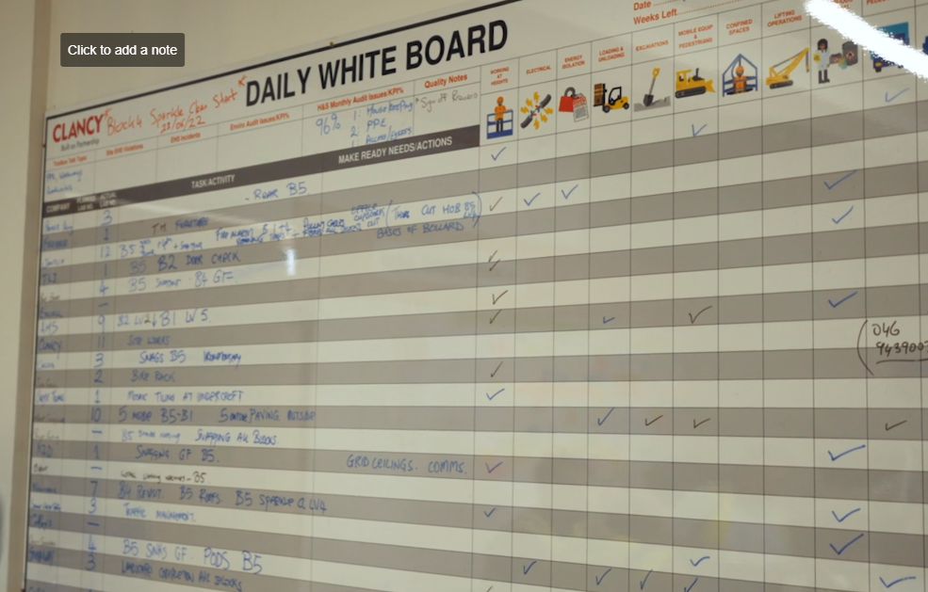
Productivity - Lean project by Clancy
Progressive Contractor with multiple investments in digital, innovation, process improvement.
Introduced the Last Planner System on a pilot basis.
Systemises collaboration and coordination among project stakeholders. With increased offsite, this becomes even more important.
Now upskilling teams to Yellow and Green Belt level with the delivery and execution of productivity improvement projects.
BuiltToInnovate
An initiative of Enterprise Ireland
under the Housing For All Plan.

Slide 13
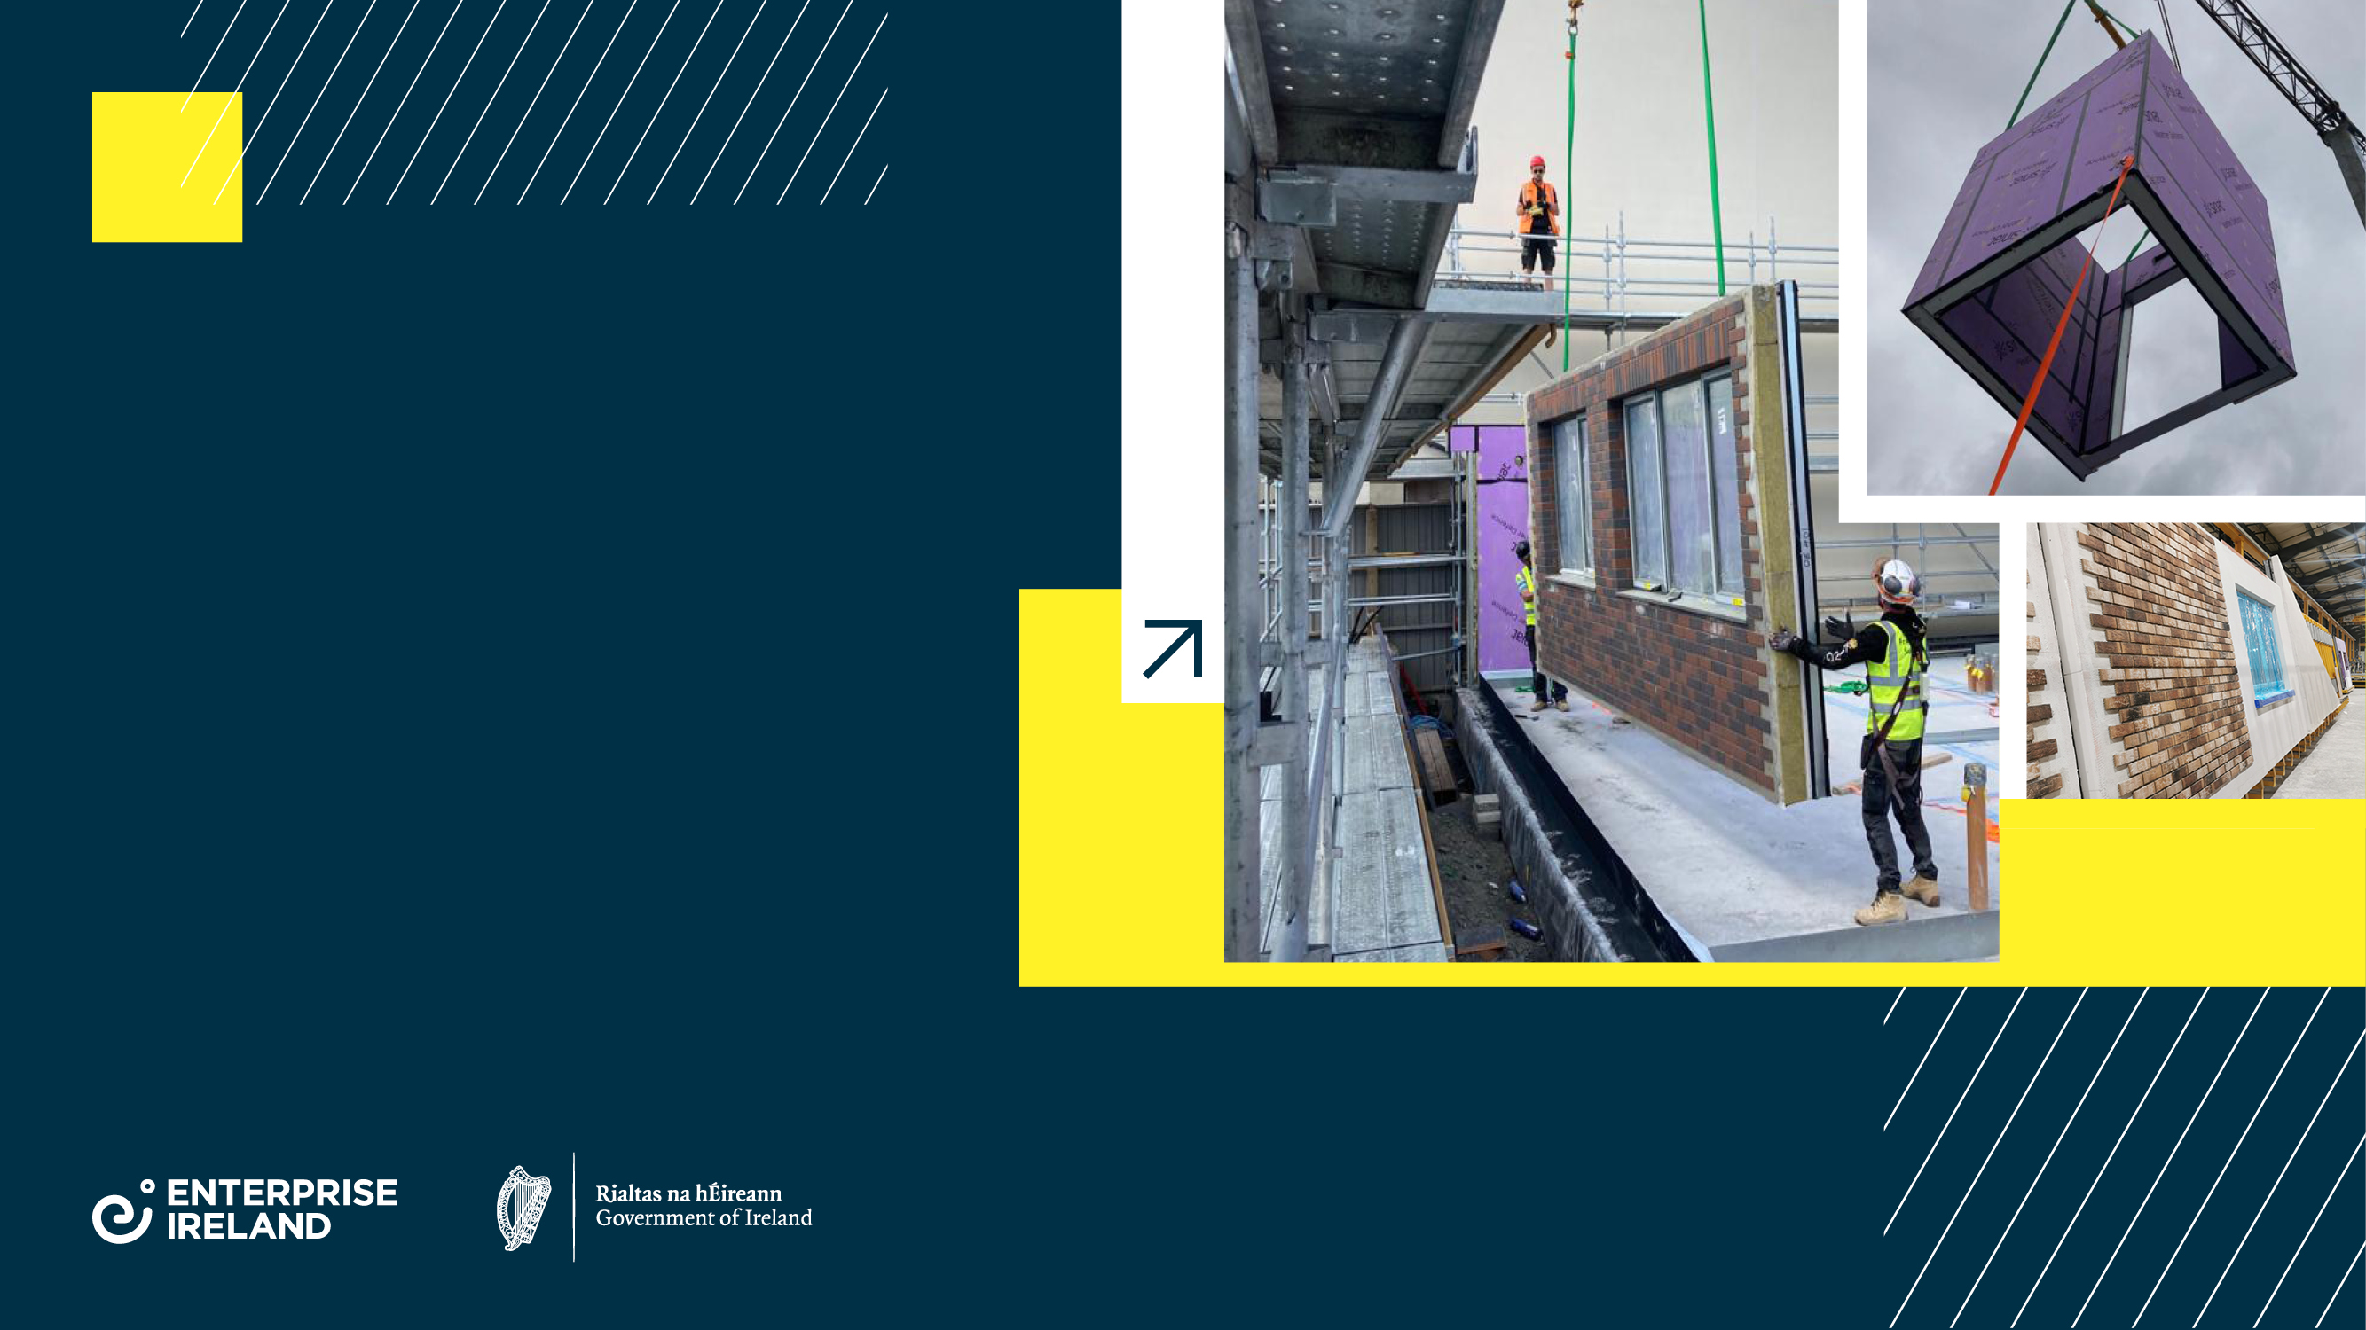
Thank you.

