Slide 1
[INSERT WEBINAR TITLE]
WEBINAR TITLE | Digital Transformation
PRESENTER | Elaine Harrington
ORGANISATION | Suir Engineering Ltd.,
DATE | 30th November 2023

Slide 2
Introduction
Elaine Harrington – Continuous Improvement Manager
Specialist in Business Management, Commercial and Lean Enterprise Excellence - Black belt in Lean.
Notes:
Suir Engineering is an Irish Contractor that has near 40 years’ experience in delivering mechanical, electrical and instrumentation (M,E&I) services. We are leading the way in the industry within Europe, employing more than 2000 people and expected turnover of over €400 million in 2023. The sectors in which Suir Engineering operates include data centres, energy power & renewables, pharmaceutical and food & beverage. Suir Engineering's recurring customers both in Ireland and overseas account for most of its business. Suir continuously examines each client's operations to better comprehend their specific needs and sets in place the structures that will enable it to do so.
John Kelly, who just assumed CEO at Suir Engineering, will guide the company in positioning itself for the future and the enormous growth prospects that the company has while ensuring that we continue to deliver high standards of performance that our customers have come to expect.
Suir Engineering people
The foundation of Suir Engineering's success as a company is its workforce.
Every member of the team at Suir Engineering is respected, encouraged to accept personal responsibility, and given support to grow and reach their full potential. Suir Engineering has a history of good staff retention and developing talent level to director.

Slide 3
AGENDA
Introduction to one Digital transformation project
Define our Digital Transformation Strategy
Key Elements in Our Journey
Assessing the Current State
Setting our goals and objectives
Building the Team
Technology
Resources
Challenges
Conclusion

Slide 4
Elements in our Story
Manual Process
Improve efficiencies
Digitalise Process
Notes:
Manual process was a triplicate book format and involved a large volume of overprocessing, waiting, utilised staff, bottlenecks.
Improve efficiencies was to eliminate waste – TIMWOODS
Digitalise process was a two step trial first via Excel/Adobe and then build a customised app to suit.

Slide 5
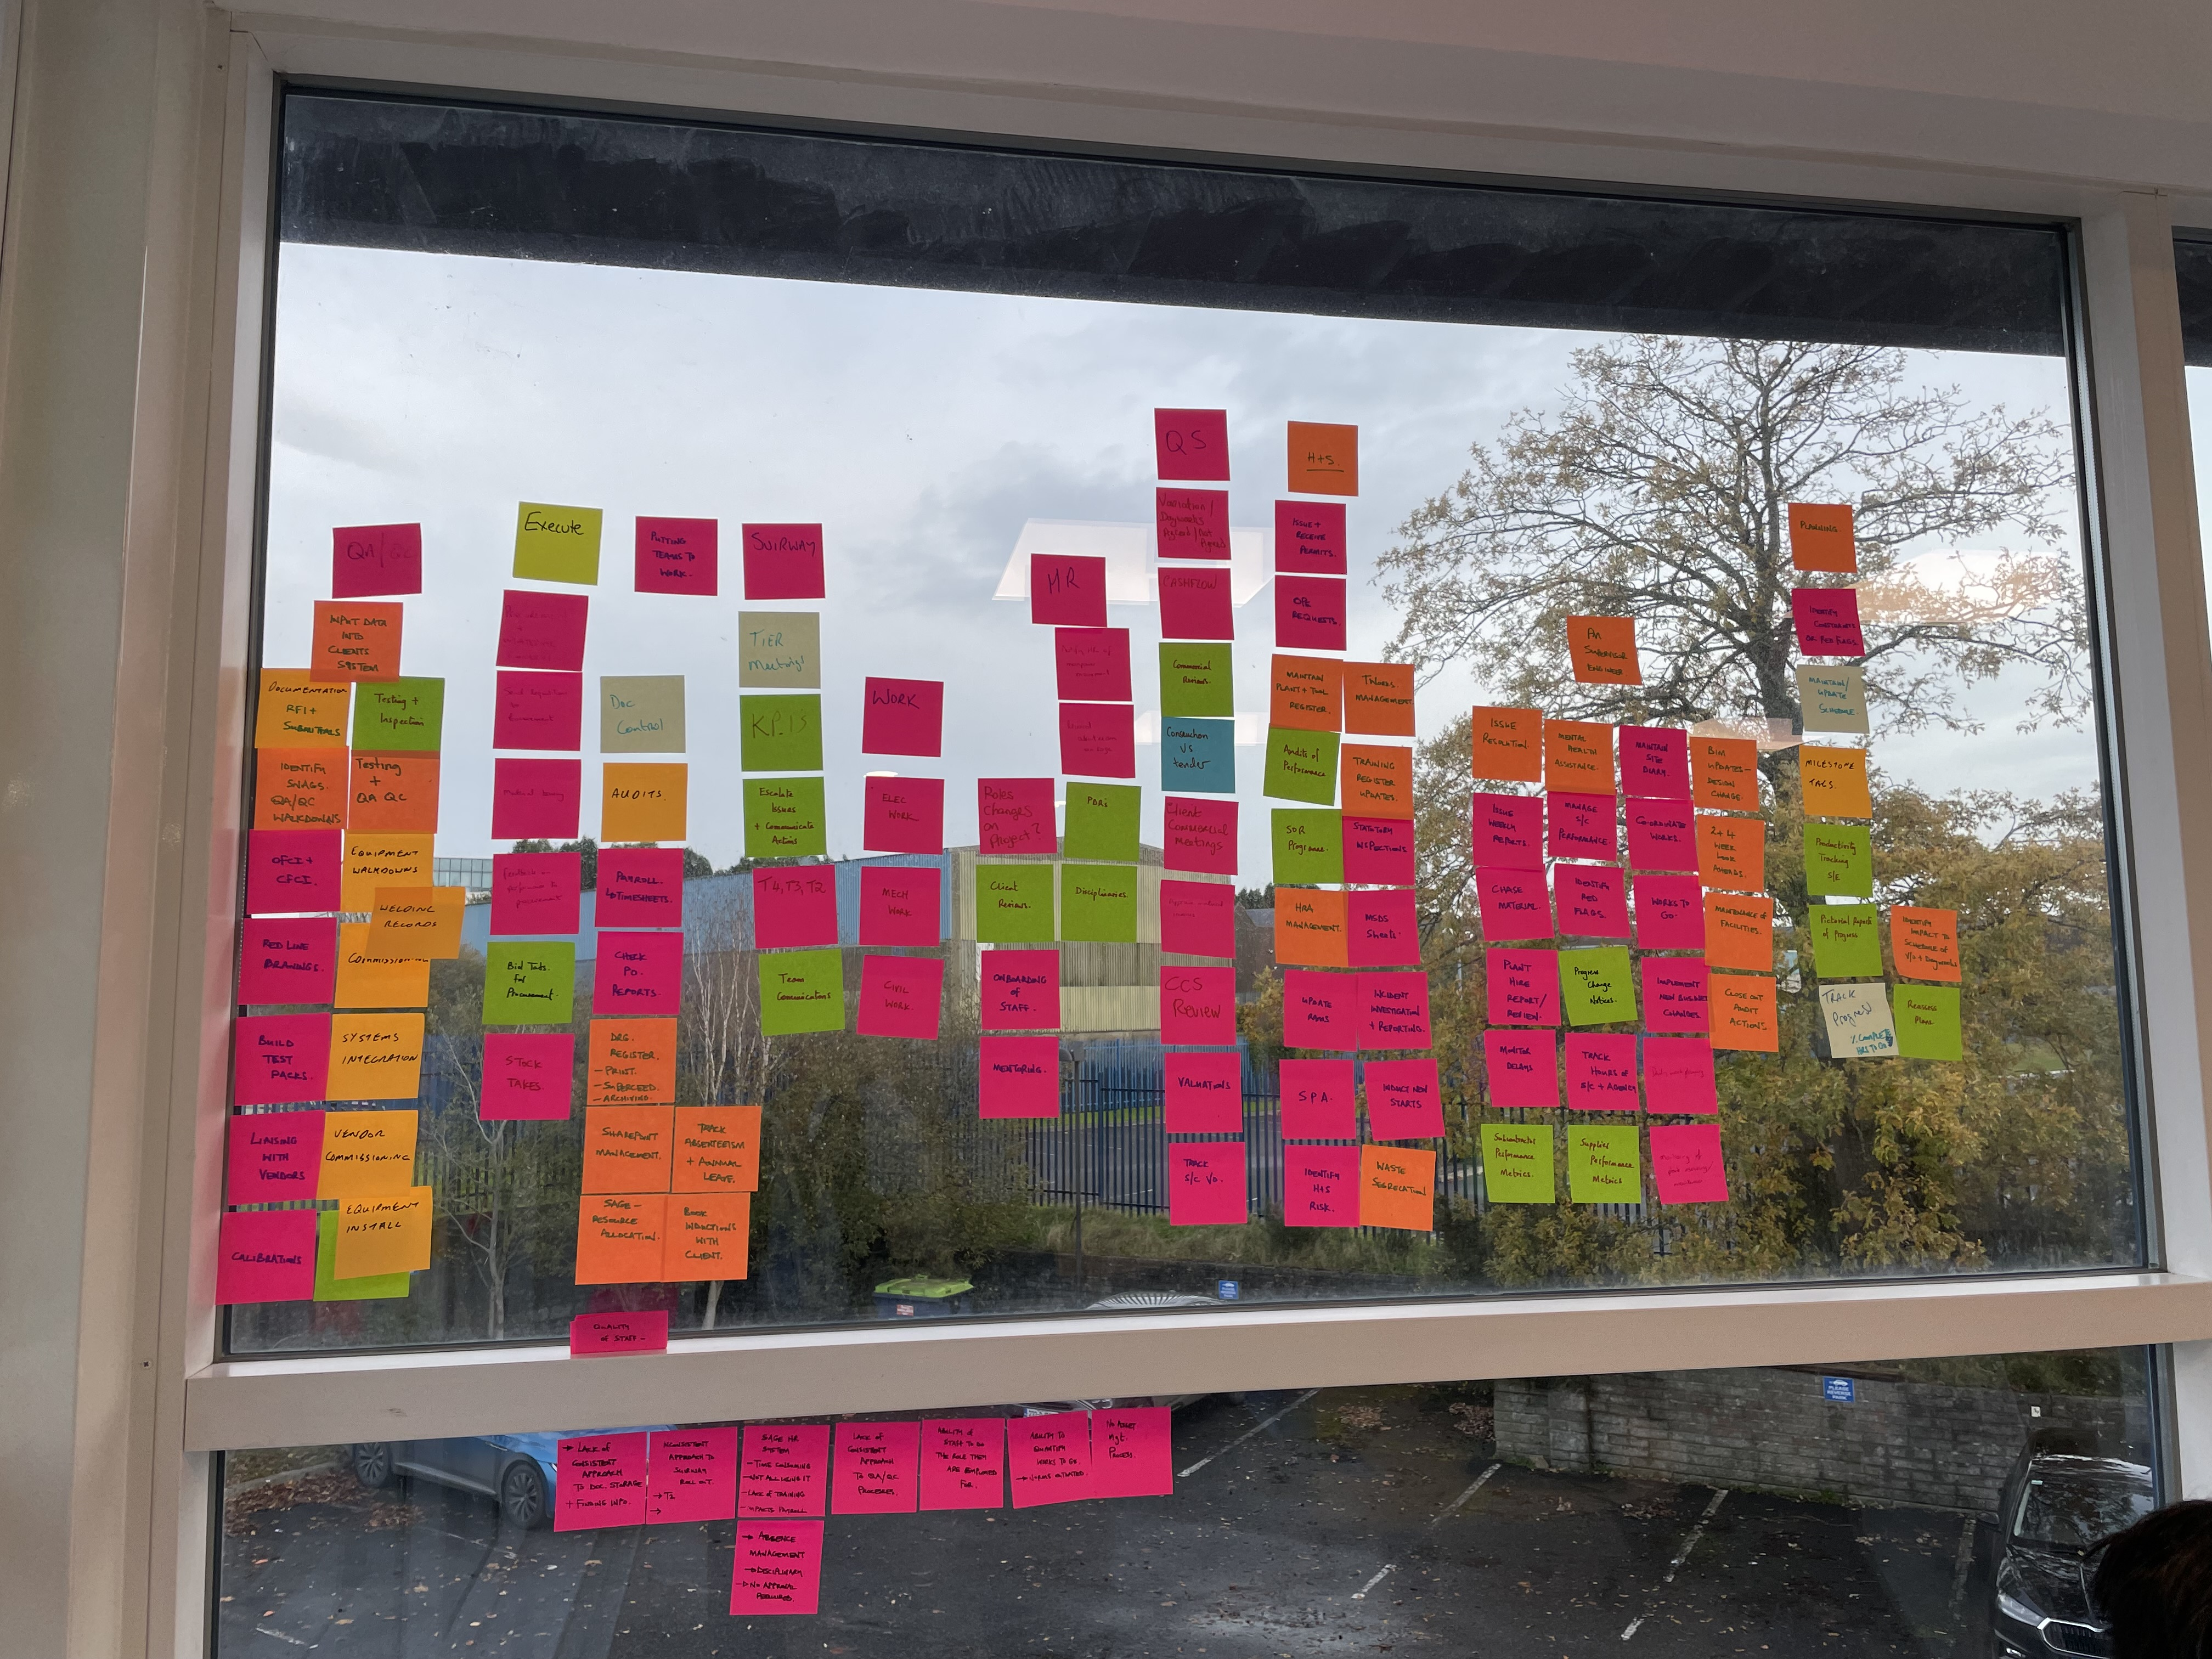
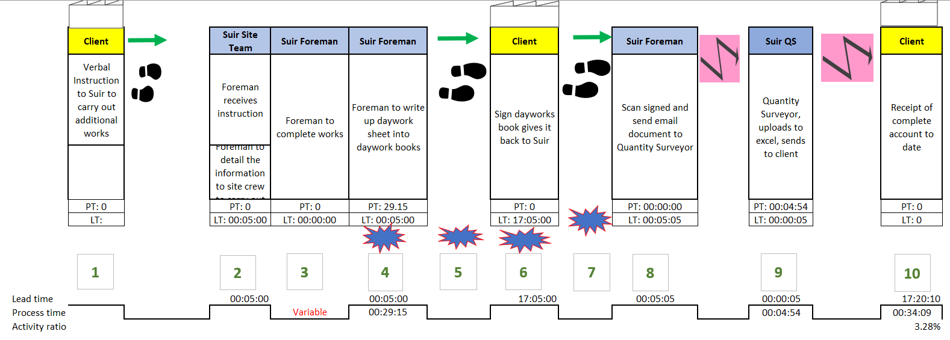
Process Map Current State
Notes:
Step by step list your processes, get the lead time and process time. Do not proceed to digitalise at this point – it is too early.

Slide 6
Improve before digitalise
"Failing to improve a process before digitalization risks automating inefficiencies and perpetuating flaws, hindering the potential benefits that digital solutions can bring."
Notes:
End to end process, collaboration of teams, identify waste.

Slide 7
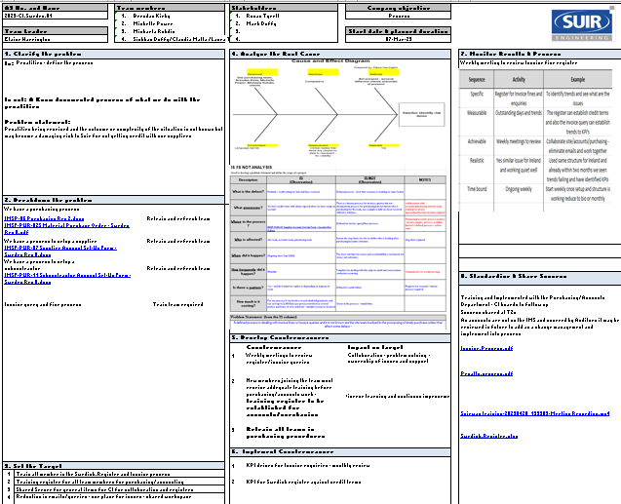
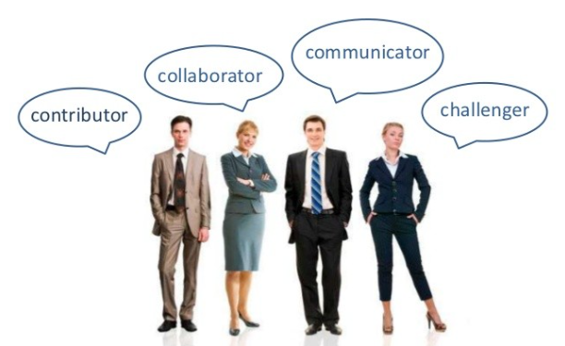
Team
Team Member
Shareholders
System support Specialists
Wireframes
Front end
Back end
UAT testing
Bug fixes
Data security

Slide 8
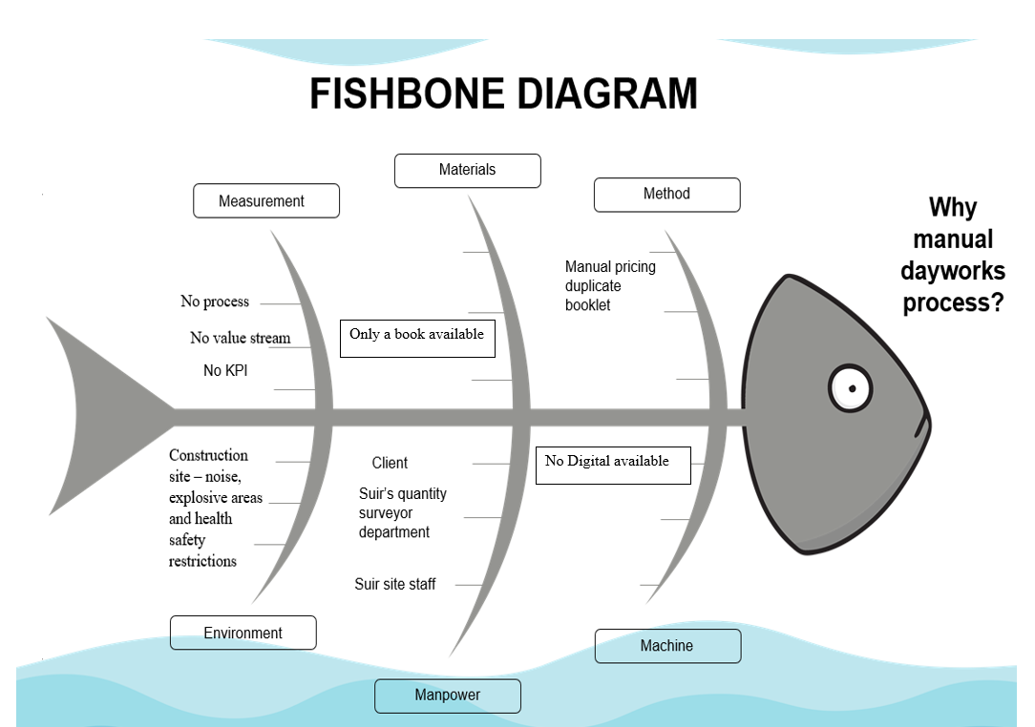
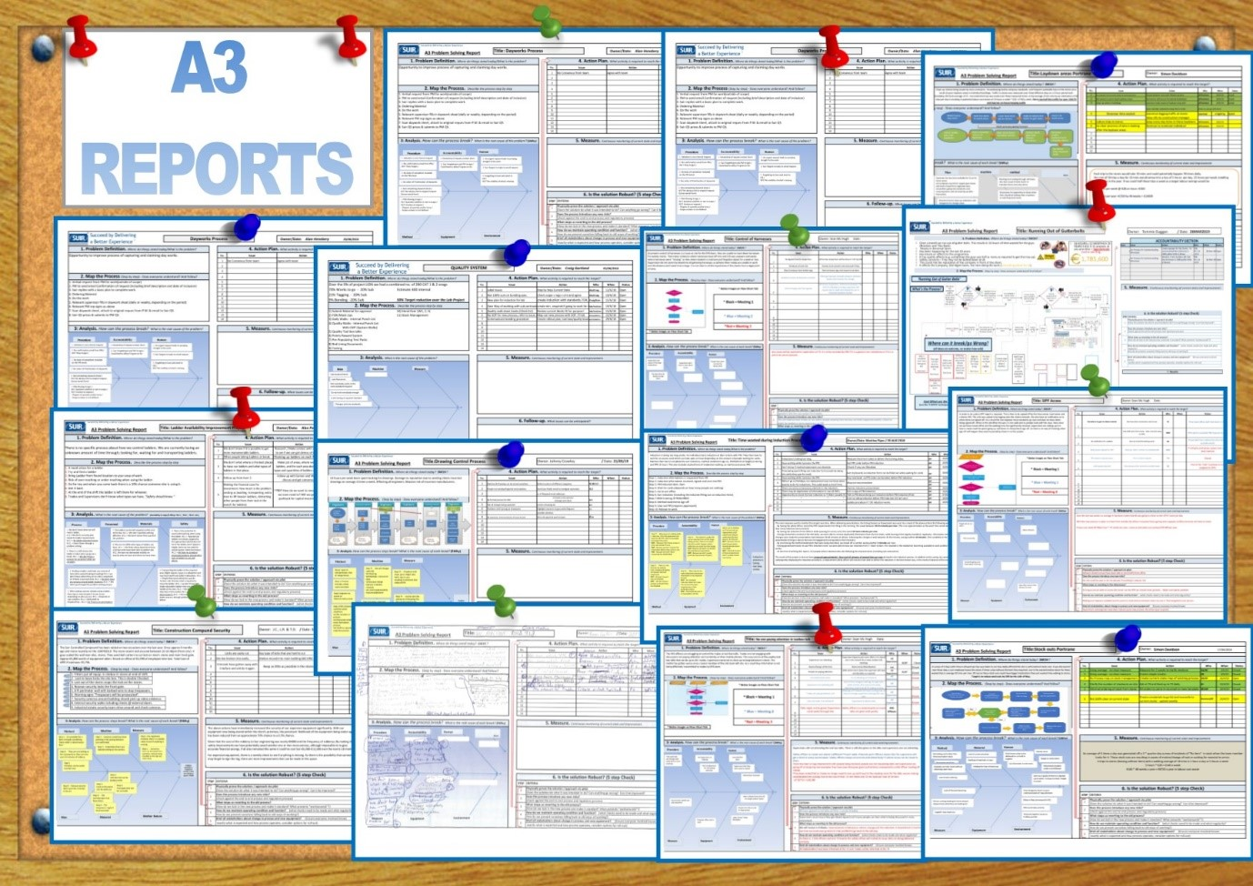
Steps along the way
Notes:
Scope the entire works, assign the team, root cause any problems in the process – Use A3, clarify the problems, breakdown the problems, root cause, countermeasures, monitor results

Slide 9
Define the Strategy
Digital transformation – The journey began by defining our goal and aligning with our business.
Notes:
This was perhaps the hardest one to decide on as several stakeholders had a different opinion, it differed from improving the speed of the process, cashflow improvement, accountability and ownership, elimination of waste, improving our carbon footprint, - We defined our digital transformation as the blueprint for the way we do our business

Slide 10
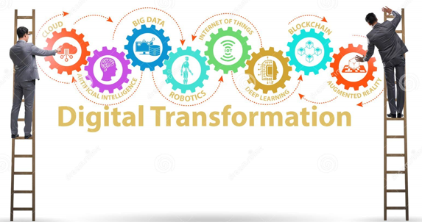
Digital transformation involves leveraging digital technologies to overhaul traditional and non-digital business processes and services, adapting to evolving market and customer expectations, thereby fundamentally changing how businesses are managed, operated, and deliver value to customers
Notes:
Emphasize that it's not just about technology but also about changing the way business operates and delivers value.
You must weigh up the benefits of adding a digital service to your improvement, making something digital does not ensure it becomes efficient.
Customer-centric – feedback, regular reviews, interactions with customers. Adapt to learning, find your people, keep eye on what others are doing.
Construction trends – Virtual design and BIM to improve schedule and budgets, Prefab and modular construction, Smart Cities, Green buildings, Drone technology, Safety, Diversity in labour force, material costs, and the use of 3D printing, Robotics and automation.

Slide 11
Challenges
Expertise in Computer System Solutions is essential – Process/Timescale/Bespoke or off the shelf.
Importance of trials.
Pay attention to feedback regarding flaws, fixes, and problems.
Promote diversity within teams.
Implement effective change management.
Adopt an Agile approach.

Slide 12
Digital Journey - Technology
VALUE TO CLIENT
TIME TO PEOPLE
CARBON FOOTPRINT
CI CULTURE
EFFICIENCY
LEAN CULTURE
SUCCESS/FAIL
Notes:
Note the project should remain with the leader and adapt a CI approach and check in routinely. Measurement

Slide 13
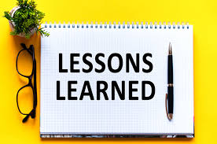
Conclusion
DOCUMENT LESSON LEARNED FROM THE START
Applying lessons learned (pmi.org)
Notes:
Note the project should remain with the leader and adapt a CI approach and check in routinely. Measurement – Identify, document, analyse, store, retrieve your lessons learned

Slide 14
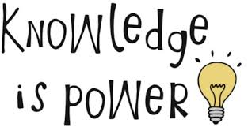
Resources
https://leanconstructionireland.ie/resources/
https://www.wit.ie/courses/master-of-business-in-lean-enterprise-excellence
https://www.academia.edu/
https://learning.linkedin.com/elearning-case-studies?selectedFilter=all%2Fall

Slide 15
Thank you from
Elaine Harrington
eharrington@suireng.ie
087-4051484
Questions & Answer

